Slide 1
Slide 1
Explicit Instruction
Modeling and practicing to help students reach academic goals
Module 5

Slide 2
Slide 2
Explicit Instruction
Modeling and practicing to help students reach academic goals
Introduction: What is explicit instruction and why is it important?

Slide 3
Slide 3
Part 1: Clear Objective
You’ll learn to
Select objectives based on student performance relative to goals.
Write focused objectives that describe the specific learning outcome.
Write clear explanations.
Design planned examples.
Evaluate the effectiveness of instructional models.
Decide when students are ready to practice and whether it should be guided or independent.
Design guided practice activities led by the teacher.
Design independent practice activities students can do successfully on their own.
Part 2: Modeling
Module objectives
Part 3: Practice

Slide 4
Focus on explicit instruction Definition
A way of teaching where the teacher
selects an important objective,
specifies the learning outcome,
designs structured instructional experiences,
explains directly,
models the skill being taught, and
provides scaffolded practice to achieve mastery
important objective
learning outcome
structured
explains directly
models
scaffolded practice

Slide 5
Focus on explicit instruction Rationale for using it
Research has shown repeatedly that it leads to student success (Adams & Engelmann, 1996; Hattie, 2009, 2018)
Specific parts are very effective (Alfieri, 2011; Hattie, 2018):
Direct explanations
Modeling
Structured practice
Providing feedback
It works in both language arts and mathematics classrooms (Cohen, 2018; Haas, 2005)

Slide 6
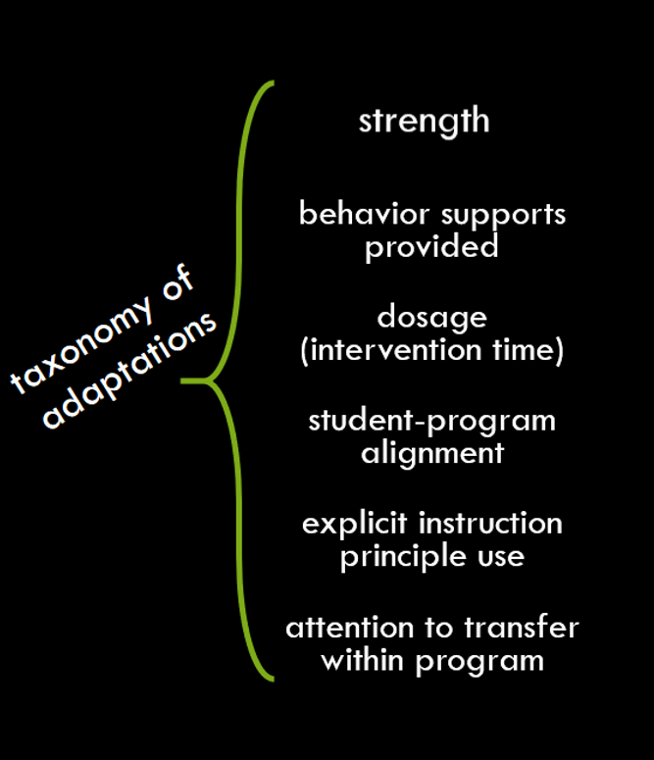
Explicit instruction within DBI
Teacher implements program with fidelity.
Student shows insufficient
response.
Work samples show students are confused.
Data show some progress
Teacher tries something simple.
Teacher realizes she needs to change instruction.
Progress remains insufficient.

Slide 7
Explicit instruction within DBI
Teacher implements program with fidelity.
Student shows insufficient
response.
With a secondary prevention program
Work samples show students are confused.
Data show some progress
what to teach
too many skills are jumbled together
the expectations are not clear
lessons are activity-driven
how to teach
not specified at all
not explicit
Teacher tries something simple.
Teacher realizes she needs to change instruction.
Without a program
what to teach
you have to decide (very hard work)
how to teach
you must design explicit instruction

Slide 8
Slide 8
Clear Objective
Important focus
Specific learning outcome
I Do
Modeling
Practice
Clear Explanation
Guided
Practice
We Do
Planned
Examples
Independent Practice
You Do
Supporting Practices
Supporting Practices
Using effective methods to elicit frequent responses
Providing immediate specific feedback
Maintaining a brisk pace

Slide 9
Activity 5.1 Read & Reflect
Why do we use explicit instruction?
Read
Find the Martin (2016) section titled “The cognitive architecture of the human mind: Working and long-term memory” on pp. 7-9
Use the notetaking guide in the workbook to support your reading
Reflect
Students who need intensive intervention often have working memory difficulty. From Martin’s point of view, how should we design instruction to maximize learning for these students?
Some educators focus on discovery learning, where groups of students are given complex real-world problems and work together to solve them with little guidance (Mayer, 2004).
Why might this present a challenge for students who need intensive intervention?
If a friend of yours was such an educator, what would you tell them about the needs of students who need intensive intervention?

Slide 10
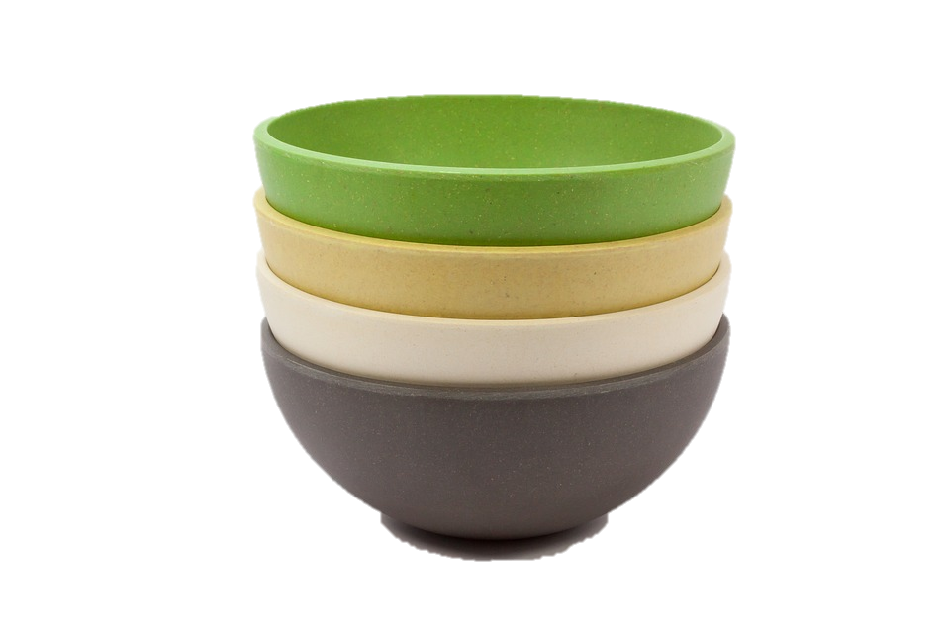
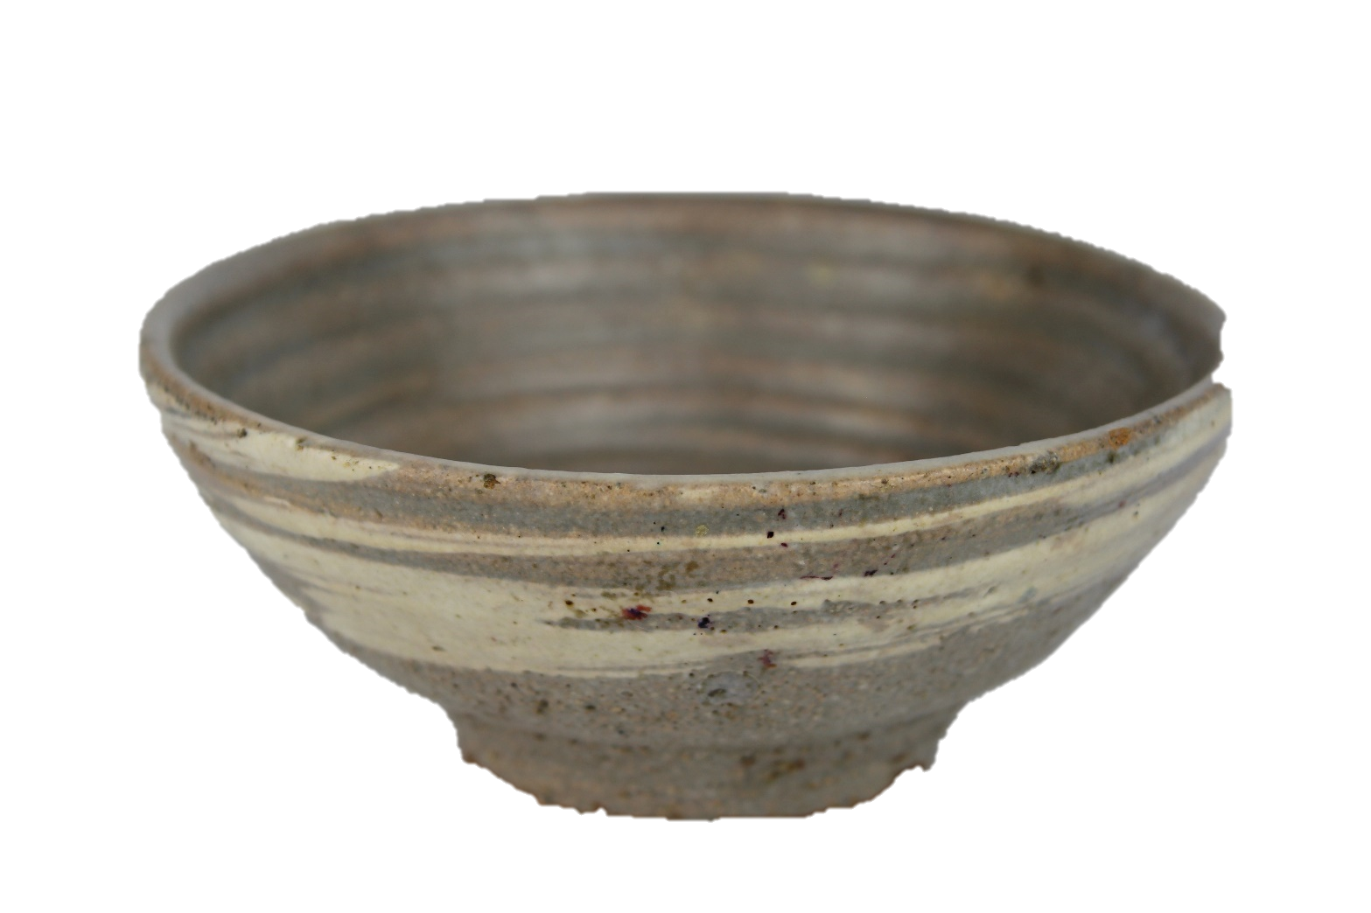
Slide 10
stones
… in a bowl

Slide 11
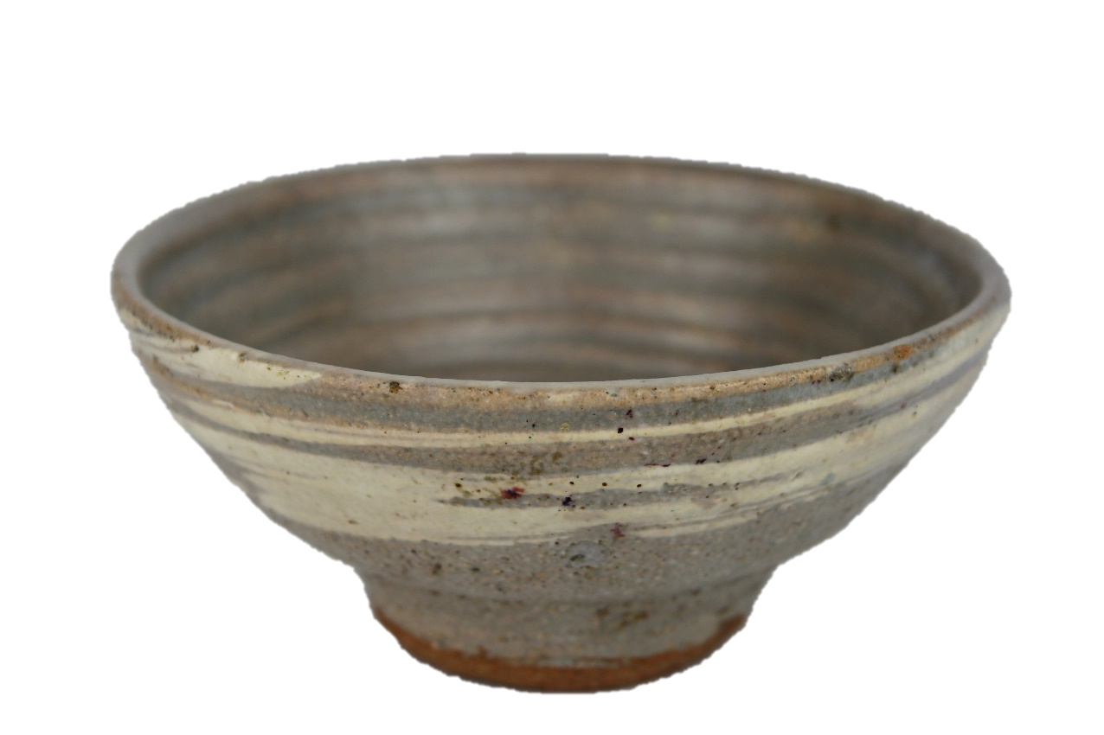
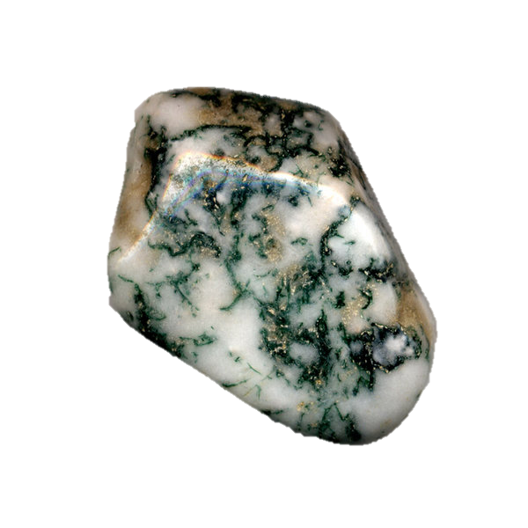
Slide 11
students who need intensive intervention
students with typical achievement
cognitive load
cognitive load
knowledge
How do we help both types of students acquire knowledge?

Slide 12
Slide 12
students with typical achievement
instructional approach

Slide 13
Slide 13
students who need intensive intervention

Slide 14
Slide 14

Slide 15
Slide 15
a cairn of knowledge…
through explicit instruction

Slide 16
Activity 5.2 Stop & Jot
In your workbook, answer these questions about the analogy:
Why does the same instructional approach produce such different academic outcomes for each type of student?
How is explicit instruction different from other ways of providing instruction?
Why does it work so well for students who need intensive intervention?

Slide 17
Representation of explicit instruction
Devin
has an objective, to cut onions that can be used for cooking
tries to cut onions on his own
Devin Kearns & Sarah Powell (2016)

Slide 18
How does it go?
Link to Video: https://youtu.be/W4ysP2rfyGE
Devin Kearns & Sarah Powell (2016)

Slide 19
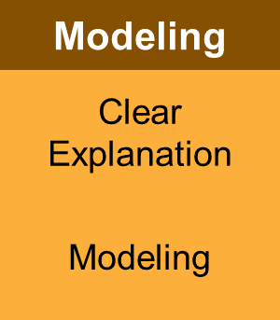
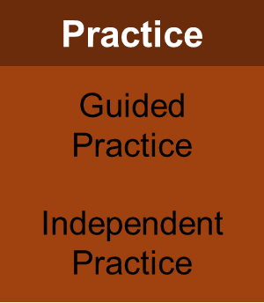
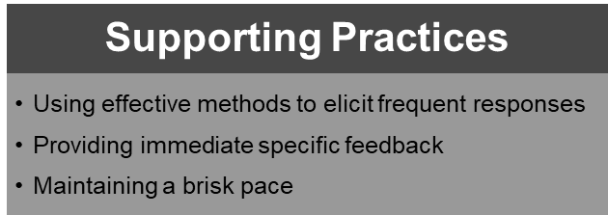
Representation of explicit instruction
Devin
has an objective, to cut onions that can be used for cooking
tries to cut onions on his own
needs explicit instruction
That’s what Sarah provides by…
Devin Kearns & Sarah Powell (2016)

Slide 20
Watch Sarah teach Devin using explicit instruction
Link to Video: https://youtu.be/lMY2cTJJHvA
Sarah Powell & Devin Kearns (2016)

Slide 21
Activity 5.3 Analyze Devin and Sarah’s video
What roles do Devin (student) and Sarah (teacher) play?
Phase | Devin’s Role | Sarah’s Role
Modeling
Guided Practice
Independent Practice
Notes:
Video from 2.30 to 3.55

Slide 22
A real classroom example
Dr. Archer is an expert in explicit instruction (and co-author of the Explicit Instruction book)
Her objective is for students to use a response format she has not taught them before
She uses a short (but complete) cycle of explicit instruction
Link to Video: https://explicitinstruction.org/video-elementary/elementary-video-1/
Anita Archer (n.d.) ExplicitInstruction.org
Archer, A., & Hughes, C. (2011). Explicit Instruction. New York, NY: The Guilford Press

Slide 23
Activity 5.4 Analyze a Video Example
How does Dr. Archer use explicit instruction?
Phase | What Dr. Archer does | What students do
Modeling (Explanation) | I’ll ask a question, I will put up my hands, this says think do not blurt, and when I lower my hands right there you’ll say the answer.
Practice (Independent) | What day of the week is it, everyone? It’s … | They say it’s November.
Practice (Independent) | So what day of the week is it? Think.
Modeling (Explanation) | Now let’s practice that again, this is think, you don’t say it until I lower my hands right there, okay?
Practice (Guided) | So what day of the week is it everybody? It’s…?
Practice (Independent) | Of course, tomorrow it will be?
Practice (Independent) | After Saturday?
Notes:
Video from 2.30 to 3.55

Slide 24
Module 5 Activities
Notes:
Himmele, W., & Himmele, P. (2012). How to know what students know: Total participation techniques get all students engaged with content, giving teachers feedback about what they know. Educational Leadership. 58-62.

Slide 25
Slide 25
Classroom Application
You’ll execute a lesson
In the Journal, you’ll write
Design an explicit lesson including a model that involves a clear explanation and planned examples
Teach the lesson you design
Complete the checklist
Reflect on the lesson with your coach
or a peer
or your instructor
your learning outcome
Use the format in this module
Describe how it aligns with the student’s goals
Describe how it matches the student’s current needs
a clear explanation of the lesson content
a description of your practice activities and a explanation why you chose this kind of practice

Slide 26
References
Adams, G. L., & Engelmann, S. (1996). Research on Direct Instruction: 25 Years beyond DISTAR. Seattle, WA: Educational Achievement Systems.
Alfieri, L., Brooks, P. J., Aldrich, N. J., & Tenenbaum, H. R. (2011). Does discovery-based instruction enhance learning? Journal of Educational Psychology, 103, 1-18.
Archer, A., & Hughes, C. (2011). Explicit Instruction. New York, NY: The Guilford Press
Archer, A. , & Hughes, C. (n.d.). Active participation instruction – 2nd grade [Video File]. Retrieved from https://explicitinstruction.org/video elementary/elementary-video-1/
Cohen, J. (2018). Practices that cross disciplines?: Revisiting explicit instruction in elementary mathematics and English language arts. Teaching and Teacher Education, 69, 324-335.
Haas, M. (2005). Teaching methods for secondary algebra: A meta-analysis of findings. NASSP Bulletin, 89, 24-46.
Hattie, J. (2009). Visible learning: A synthesis of over 800 meta-analyses relating to achievement. London and New York: Routledge.
Martin, A. J. (2016). Using Load Reduction Instruction (LRI) to boost motivation and engagement. Leicester, England: British Psychological Society.
Mayer, R. E. (2004). Should there be a three-strikes rule against pure discovery learning? American Psychologist, 59, 14.
Devin Kearns & Sarah Powell (2016). Explicit instruction [Video File]. Retrieved from https://www.youtube.com/watch?v=T-6cCgS8Eio

Slide 27
Slide 27
Explicit Instruction
Modeling and practicing to help students reach academic goals
Part 1: How do you create objectives with appropriate learning outcomes?

Slide 28
Slide 28
Objectives (on objectives)
You’ll learn
why objectives are relevant within DBI
how to select objectives based on student performance relative to goals.
how to create focused objectives that describe the specific learning outcome that shows mastery.

Slide 29
Role of objectives in explicit instruction
Modeling
Practice
Clear Explanation
Guided
Practice
but you have to teach something meaningful
Planned Examples
Independent Practice
Supporting Practices
Using effective methods to elicit frequent responses
Providing immediate specific feedback
Maintaining a brisk pace

Slide 30
Importance of objectives in DBI
In DBI …
Student needs an adaptation
Teacher decides to increase use of explicit instruction principles
Increasing explicitness requires very clear objectives
But..
DBI is based on implementing secondary prevention programs
So …
Why are we talking about objectives?

Slide 31
Importance of objectives in DBI
If you have a secondary prevention program, it
may not specify objectives in a way that maximizes learning
may try to cover too many objectives at once
design learning outcomes that do not match stated objectives
If you do not have a program, you will need to
define clear objectives for lessons
specify appropriate learning outcomes

Slide 32
These modules are about instruction! Why focus on objectives?
The objective focuses instruction on exactly what we want students to learn
Without an objective, lessons end up being about
a topic
an activity
We are learning about triangle congruence.
I’m teaching them about cause and effect.
Worksheet
Answer these questions:
Venn Diagram

Slide 33
These modules are about instruction! Why focus on objectives?
The objective focuses instruction on exactly what we want students to learn
Without an objective, lessons end up being about
a topic
an activity
This can be true even when using a secondary prevention program. The authors do not always write lessons with good objectives, and that makes them hard to use.

Slide 34
Here’s an example of what happens …
The teacher works with a small group of fifth graders who need intensive intervention in reading comprehension and is planning a lesson for the coming week.
The program suggests I read this book with the students, but it doesn’t say how to do it.
So, how can I read the book with students? I’ll use the Survey, Question, Read, Recite, Review strategy I read about on a website for teachers.
The teacher writes in the lesson plan book…

Slide 35
This is not an objective
This is an activity
The teacher did not even think it through
The learning outcome is not specified
What does “together” mean?
Are you going to do this for all 20 pages?
Are they going to fill in the whole graphic organizer?
Will you have a copy for the projector or draw it on the board?
Will students be prepared to do this without prior instruction?
Planning by Mr. Kearns, a second year teacher with lousy objectives

Slide 36
This happens to many of us
We do organizational planning
The activity
The materials
We do not to cognitive planning
We do not clearly see the learning outcome
We do not select activities and materials focused on meeting the objective as shown by the learning outcome
So, what happened to Mr. Kearns?
He ended up having students completing the organizer together.
The lesson was not focused because he was searching for the objective during the lesson.
He did not get there, so students built no new skills. They just copied down some words.

Slide 37
Activity 5.5 Journal Entry
Describe a time in your teaching experience that you have focused on organizational planning rather than cognitive planning.
How “susceptible” are you to focusing on organizational planning?
What are the conditions that make you focus on cognitive planning?

Slide 38
Checklist for Objectives
Choose objectives based on student performance relative to goals.
Select a goal from IEP or standards
Choose an objective that is the next step toward the goal
Write focused objectives that describe the specific learning outcome.
Limit the objective to one singular next step toward the goal
Describe a learning outcome in behavioral terms that assesses mastery of the objective

Slide 39
Student Case Studies
Ariana
Student in Grade 3
Focus on beginning reading
Current level is Grade 1
Has an IEP for reading
Noah
Student in Grade 5
Focus on reading comprehension
Current level is Grade 1
Has an IEP for reading
Martin
Student in Grade 3
Focus on mathematics
Current level is Grade 2
Needs intensive intervention

Slide 40
Checklist for Objectives
Choose objectives based on student performance relative to goals.
Select a goal from IEP or standards
Choose an objective that is the next step toward the goal
Write focused objectives that describe the specific learning outcome.
Limit the objective to one singular next step toward the goal
Describe a learning outcome in behavioral terms that assesses mastery of the objective

Slide 41
Select a goal from IEP or standards
The goal
A long-term outcome
An ambitious but reasonable expectation
A base for a specific lesson’s objective
Role of the IEP in selecting a goal
The IEP contains goals already
They should meet the above criteria
Role of standards in selecting a goal
Grade-level standards represent the long-term expectation for all
Goals may be based on
instructional-level standards
foundational skills that build toward the grade-level standard

Slide 42
Select a goal from IEP or standards
The goal
A long-term outcome
An ambitious but reasonable expectation
A base for a specific lesson’s objective
IEP
Goals:
Read one-syllable words with complex sound-spellings including vowel teams and vowel-consonant-E pattern using appropriate decoding strategies
Read level-appropriate texts with intonation and fluency
Ariana’s goal
Word reading
Standards
Grade 3:
Find the area of a rectangle with whole-number side lengths by tiling it, and show that the area is the same as would be found by multiplying the side lengths
Grade 2:
Partition a rectangle into rows and columns of same-size squares and count to find the total number of them
Martin’s goal
Grade 2 standard

Slide 43
Brief explanation of partitioning
8 square units

Slide 44
Activity 5.6 Stop & Jot
The goal
A long-term outcome
An ambitious but reasonable expectation
A base for a specific lesson’s objective
Noah’s IEP goals
Answer who, what, where, and when questions about text
Determine the main idea of paragraphs and sections of text
Standards
Grade 5 (grade-level)
Quote accurately from a text when explaining what the text says explicitly and when drawing inferences from the text
Grade 3 (instructional-level
Ask and answer questions to demonstrate understanding of a text, referring explicitly to the text as the basis for the answers
What goal should anchor the lesson?

Slide 45
Activity 5.6 Stop and Jot
The goal
A long-term outcome
An ambitious but reasonable expectation
A base for a specific lesson’s objective
What goal should anchor the lesson?
The IEP goal is designed to be an ambitious but reasonable long-term outcome
The Grade 5 standard
too advanced
represents the ultimate goal—but not the present focus
The Grade 3 standard aligns with the IEP goal
adds clarity to IEP goal

Slide 46
Checklist for Objectives
Choose objectives based on student performance relative to goals.
Select a goal from IEP or standards
Choose an objective that is the next step toward the goal
Write focused objectives that describe the specific learning outcome.
Limit the objective to one singular next step toward the goal
Describe a learning outcome in behavioral terms that assesses mastery of the objective

Slide 47
Choose an objective that is the next step toward the goal
Beginning with current skill level relative to goal
determine a student’s current level of performance
use assessment data
consider previous instruction (especially if you just finished it!)
Selecting an objective that moves toward the goal
Not too easy
Not too difficult
Why is it important not to be too difficult?

Slide 48
Choose an objective that is the next step toward the goal
From goal to objective
Evaluate current performance relative to the goal
Select an objective that is the next step
Ariana’s goal:
Read one-syllable words with complex sound-spellings including vowel teams and vowel-consonant-E pattern using appropriate decoding strategies
Current skill
Mastery of short-vowel spellings, single-letter consonants, some consonant digraphs
Next step
More consonant digraphs
Vowel digraphs
Martin’s goal
Partition a rectangle into rows and columns of same-size squares and count to find the total number of them
Current skill
Mastery of shape names and characteristics, repeated addition, and dividing into halves
Next step
NOT partitioning rectangles
Partitioning squares? Partitioning with a geoboard? Using tiles to partition?

Slide 49
Activity 5.7 Stop and Jot
The goal
A long-term outcome
An ambitious but reasonable expectation
A base for a specific lesson’s objective
Noah’s goal:
Answer who, what, where, and when questions about text
Current skill:
Practice retelling
Mastery of answering who, what, where, and when questions about himself
Next step:
Question
Should he answer these four types of questions next?
What’s your rationale?
What might be another next step?

Slide 50
Activity 5.7 Stop and Jot
Should he answer these four types of questions next?
Not all at one time
What’s your rationale?
Doing them all at once is too much
He can answer these about himself, but that does not require text evidence
He may not have mastered retelling, but it may be appropriate to increase that skill by practicing
What might be another next step?
Focus on one type of question, perhaps “who.”

Slide 51
Checklist for Objectives
Choose objectives based on student performance relative to goals.
Select a goal from IEP or standards
Choose an objective that is the next step toward the goal
Write focused objectives that describe the specific learning outcome.
Limit the objective to one singular next step toward the goal
Describe a learning outcome in behavioral terms that assesses mastery of the objective

Slide 52
Writing focused objectives Limit the objective to one singular next step toward the goal Describe a learning outcome in behavioral terms that assesses mastery of the objective
❶
The objective must be singular
It addresses just one skill
It may not take much time to master the specific objective
Explicit instruction might be repeated many times in a given period of time
The objective must include a clear learning outcome with
a description of the specific skill the student will acquire
the specific way the objective will be assessed
a clear vision of what mastery looks like

Slide 53
Is the objective singular and describe the learning outcome?
Today we’re going to learn a secret letter team. A secret letter team is two letters working together as a team, but they are not next to each other. Here’s our secret letter team (point to I_E box on sound page). In this secret letter team, the letters I (point to I) and E (point to E) work together. They say /ī/. What does the letter team say?
Student: /ī/.
Yes, /ī/. But, there is also this blank space (point to blank). In a word, a letter goes here. I and E work as a team to say /ī/, but it’s a secret letter team because they are separated! This secret letter team is I-BLANK-E. What is it?
Student: I-BLANK-E.
Singular?
Yes. Students are just learning how to pronounce this grapheme.
Describes learning outcome?
Not in this section. Later…
Let’s look at some words (point to bike). This word has I-BLANK-E. The I (circle I) and E (circle E) work together to make the sound /ī/.
Now, let’s tap some words.

Slide 54
Is the objective singular and describe the learning outcome?
Warm-Up
Tell the children they will learn a song about a bug that is very, very small.
Invite them to suggest other words that mean “very small” (Possible answers: tiny, itsy-bitsy, teeny-weeny, little).
Explain that the bug they will sing about is so small that it is called “The Eency Weency Spider.”
Teach them the song and accompanying hand motions.
Singular?
No. How many objectives are there?
❶
Describes learning outcome?
No. Students just suggest words. There is no expectation they will remember
Maybe. The teacher could evaluate whether they know the song.
❷ ❸?

Slide 55
Is the objective singular and describe the learning outcome?
Focusing on the Concept
Display the Big Book poster. Explain that today the class will compare the size of different things. Invite the children to tell what is happening in the picture. Identify the setting as a country fair. Call attention to the horse and the dog beside it.
Say: The horse is big in size. Another word for big is large. The dog is little in size. Another word for little is small. Can you find and point to other things in this picture that are big? Can you find and point to other things in the picture that are little?
Singular?
No. How many objectives are there?
Describes learning outcome?
Maybe. There is no formal assessment. It is possible to listen to check accuracy of processing.
Maybe. Same rationale as (1).
❶
❷
55

Slide 56
Activity 5.8 Pause and Process
We are going to use a story map to retell the important events of a story in the correct order. This will help us better understand what we read. …
I will think about what happened in the beginning, middle, and end of the story. I will use this story map to retell the important story events in the correct order. Model this think aloud by pointing to and reading the details on the story map.
First, I’m going to think about the beginning of the story. Draw a box around the beginning to include character, setting, and problem. We learn about the main character, where and when the story takes place, and the main character’s problem or goal. In this story, the main character is a boy. The setting is one morning in a barn. The problem is that the boy wants to find the kitten.
Singular?
Describes learning outcome?

Slide 57
Activity 5.8 Pause and Process
We are going to use a story map to retell the important events of a story in the correct order. This will help us better understand what we read. …
I will think about what happened in the beginning, middle, and end of the story. I will use this story map to retell the important story events in the correct order. Model this think aloud by pointing to and reading the details on the story map.
First, I’m going to think about the beginning of the story. Draw a box around the beginning to include character, setting, and problem. We learn about the main character, where and when the story takes place, and the main character’s problem or goal. In this story, the main character is a boy. The setting is one morning in a barn. The problem is that the boy wants to find the kitten.
Singular?
Probably. If students already know beginning, middle, and end, this lesson is about putting them together.
Describes learning outcome?
Yes. The students will use a story map.

Slide 58
Write objectives Limit the objective to one singular next step toward the goal Describe a learning outcome in behavioral terms that assesses mastery of the objective
For teaching vowel teams, the teacher
consults a scope and sequence of phonics skills
finds that EE is a common vowel digraph
writes the objective to focus on that skill
The objective is that the
student will read monosyllabic words containing up to 4 sounds and the EE digraph from a list of words written on a worksheet
What if the objective were
student will understand monosyllabic words containing up to 4 sounds in the EE digraph by spelling words with this pattern.
Singular?
Yes. The only skill is reading this one type of word.
Describes learning outcome?
Yes. Students will read.
This learning outcome does not match the objective

Slide 59
Write objectives Limit the objective to one singular next step toward the goal Describe a learning outcome in behavioral terms that assesses mastery of the objective
For our area lesson, we know that it is helpful for students to use tiles to represent a rectangle in the way the students will be asked to do later. So, we can write that objective
Student will cover a rectangle with tiles, count them, and write the number of tiles when given a worksheet containing examples.

Slide 60
Lead Teacher Demonstration
Link to Video: https://youtu.be/GR7xDOwObAI

Slide 61
Selecting an appropriate objective
Topic: The roles of the branches of state government

Slide 62
Selecting an appropriate objective
1
Topic: The roles of the branches of state government
Students will learn about the roles of the three branches of state government

Slide 63
Selecting an appropriate objective
2
Topic: The roles of the branches of state government
Students will be able to state the roles of the branches of the state government by recording the definitions and using each word in a sentence.

Slide 64
Selecting an appropriate objective
3
Topic: The roles of the branches of state government
Students will learn the roles of the branches of government and how they differ by state

Slide 65
Selecting an appropriate objective
4
Topic: The roles of the branches of state government
Student will identify the different roles of the three branches of state government by selecting correct examples of their functions from a list

Slide 66
Activity 5.9 Pause and Process
How did each objective stack up against the criteria for writing focused objectives?
Identify why each did or did not meet the checklist criteria.
Choose objectives based on student performance relative to goals.
Select a goal from IEP or standards
Evaluate current performance relative to the goal
Select an objective that represents the next step toward the goal
Write focused objectives that describe the specific learning outcome.
Limit the objective to one singular next step toward the goal
Describe a learning outcome in behavioral terms that assesses mastery of the objective

Slide 67
Activity 5.10 Discussion Board
Write a short case study for a student including
a brief background for the student
the goal
the source (IEP or standards)
the next step
Post it
Read others’ goals and next steps
Write
a possible objective for someone else’s goal
how well the objectives for your case study match the checklist
Notes:
Start at 0:42 - Play until 4:10

Slide 68
Slide 68
Part 1 Wrap-Up
Key Points:
Choose objectives based on student performance relative to goals.
Write focused objectives that describe the specific learning outcome.

Slide 69
Checklist for Objectives
Choose objectives based on student performance relative to goals.
Select a goal from IEP or standards
Choose an objective that is the next step toward the goal
Write focused objectives that describe the specific learning outcome.
Limit the objective to one singular next step toward the goal
Describe a learning outcome in behavioral terms that assesses mastery of the objective
The checklists are important!
They help make your self-evaluation less judgmental
The lesson is not “good” or “bad”
The lesson “follows the checklist” or not

Slide 70
Activity 5.11 Quiz
True or False?
This is good objective for a student who understands symmetry and bilateral symmetry:
Objective: Student will learn and identify the ideas of symmetry, bilateral symmetry, and radial symmetry by creating artwork that uses these ideas.
This is a good objective for a student who has learned about the parts of a main idea statement:
Objective: Student will identify the main idea of texts.
Every lesson should have an assessment.
Teachers should teach one lesson every day.
Students who need intensive intervention but not IEPs should have objectives based strictly on grade-level.

Slide 71
Activity 5.11 Quiz
Context: Student learns about author’s point of view for the first time
6. Which of these is the better objective in this context?
Student will underline opinionated statements in a short article.
Student will determine an author’s point of view by underlining opinionated statements within a given text
7. Which checklist criteria do these objectives not meet?
Student will compare the authors’ points of view in texts students already read.
Student will identify opinionated statements.
Student will write a short essay describing the author’s point of view and giving their opinion about the author

Slide 72
Slide 72
Explicit Instruction
Modeling and practicing to help students reach academic goals
Part 2: What are the characteristics of highly effective models?

Slide 73
Slide 73
Module objectives
You’ll learn
the characteristics of a clear explanation.
how to design planned examples.
to evaluate the effectiveness of instructional models.

Slide 74
Modeling as an adaptation
Even with a secondary prevention program, you still need to consider modeling
They may not explicitly suggest modeling
You’ll need to build it in
They may not provide a clear explanation of the content
You’ll need to design one
They may not include enough models
You’ll need to create some more

Slide 75
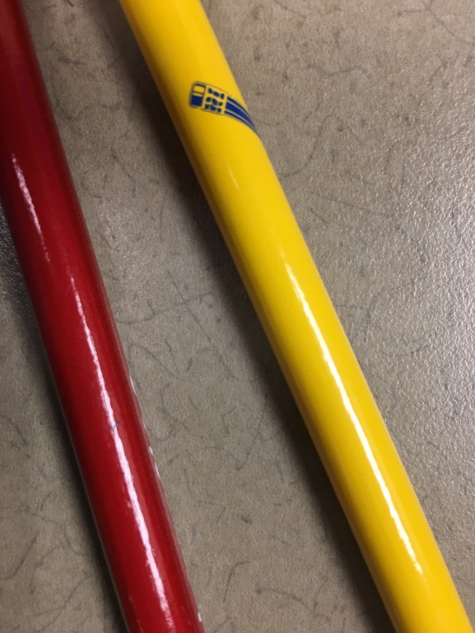
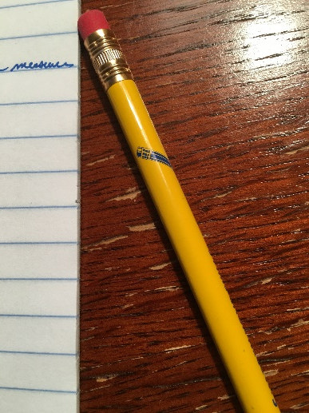
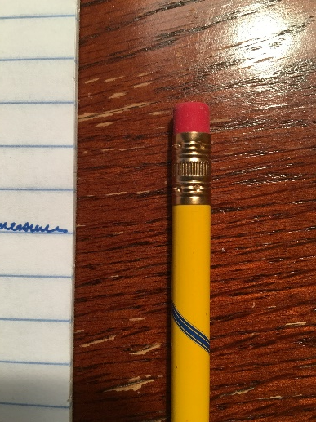
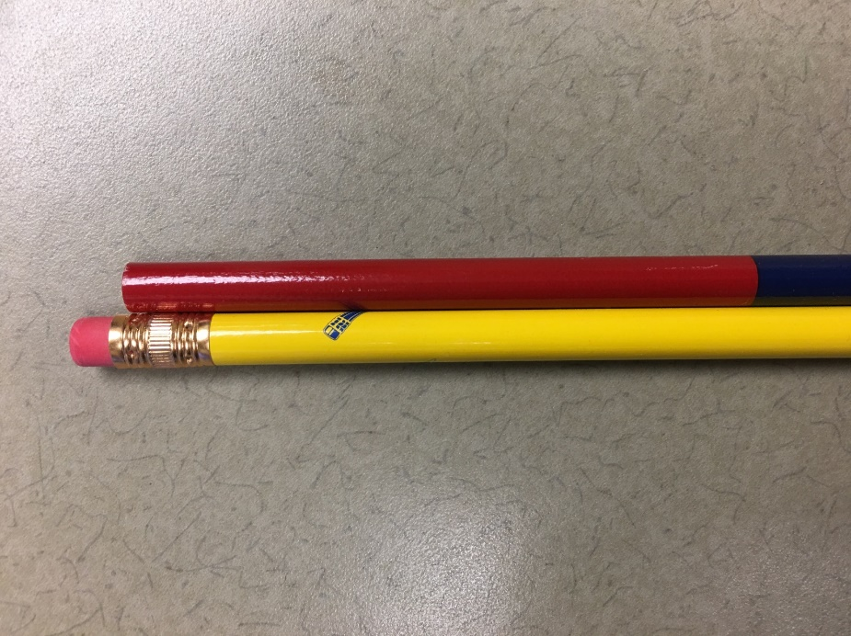
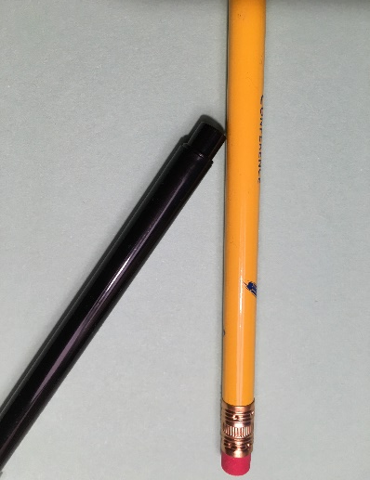
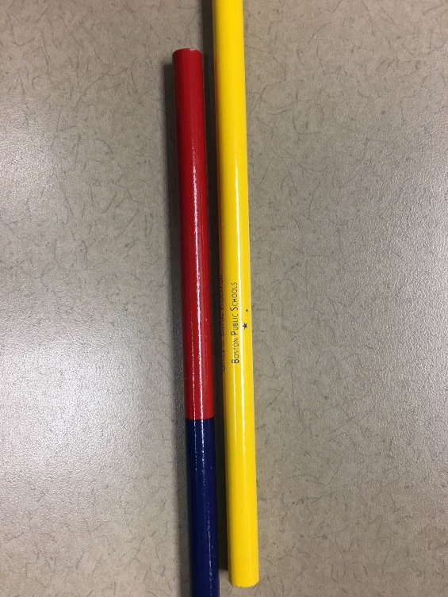
Consider this alternative to modeling
What does glap mean?

Slide 76
Activity 5.12 Stop & Jot
What does glap mean?

Slide 77
Activity 5.12 Stop & Jot
What does glap mean?
Same color?
Same image?
Same objects?
Same picture size?
Same picture shape?
Same location on page?
Same way of showing pictures?
Same number of pictures at one time?
Objects form non-parallel lines

Slide 78
Activity 5.12 Stop & Jot
What does glap mean?
My objective was that you would be able to define glap.
Did you master the objective?
As a learner, what was your cognitive and affective (emotional) experience?

Slide 79
Activity 5.12 Review
What does glap mean?
Did you master the objective?
If you did, why?
You could hold lots of examples in your working memory
You could quickly form and test hypotheses
I gave enough examples that the pattern may have become apparent
As a learner, what was your cognitive and affective (emotional) experience?
If It was cognitively overwhelming, why?
I presented information too quickly for you to process
I did not allow you to see the entire set to relieve your working memory demands
It was frustrating and caused disengagement, why?
You felt like the task was too difficult
You felt like the task was not beneficial
If it was interesting and kept you focused, why?
You liked the mental gymnastics

Slide 80
What’s the appeal of the sorting method? How could modeling have helped?
The sorting method is an inductive learning method
The appeal of this kind of inductive learning
The puzzle requires analytical (higher-order) thinking
Students might build very strong cognitive representations of vocabulary because they link the definition to their prior knowledge
The value of modeling
An explicit model reduces the cognitive load and increases efficiency for meeting my objective
Deep representations can be developed with modeling

Slide 81
The explicit instruction framework
Modeling
Practice
Clear Explanation
Guided
Practice
Planned Examples
Independent Practice
Supporting Practices
Using effective methods to elicit frequent responses
Providing immediate specific feedback
Maintaining a brisk pace

Slide 82
Activity 5.13 Read & Reflect: Martin (2016)
Martin, A. J. (2016). Using Load Reduction Instruction to boost motivation and engagement. Leicester, United Kingdom: British Psychological Society.
Read pp. 12-14
How do Martin’s instructional elements map onto the explicit instruction framework we have described?

Slide 83
In sum, what is the value of modeling
Based on our activities so far:
It reduces the cognitive load for new concepts
It can make it easier for students to meet objectives efficiently
In addition
It is part of learning theories that shows that
learning from experts promotes skill development (e.g., Bruner)
scaffolded learning supports success (e.g., Bandura)
It establishes a foundation that promotes generalization
It promotes engagement by
reducing the cognitive load
assuring constant success during learning

Slide 84
Checklist: Modeling
Give clear explanations
Match the explanation the learning outcome
Design the explanation so that it is correct, clear, and concise
Use the explanation consistently
Model multiple planned examples
Show all the steps or provide unique examples
Verbalize your thinking
Have students observe
Use supporting practices

Slide 85
Module Activities
Brief examples
Knowledge-building activities
Knowledge-building activities
Knowledge-building curriculum example
Discussions on checklists and helping others
Construct a model based on the checklist
Martin (2016)
The author’s descriptions of modeling
Try out your lesson
Lead teacher demonstration to compare ways to model
“Let me start it” activity to fix a real lesson

Slide 86
Slide 86
Part 2 Goal
Try out your model
Prepare a good model
Create a brief lesson with
a clear objective with a specific learning outcome
a clear explanation of the procedure or information
a description of the models used
After teaching the lesson, write a reflection comparing your lesson to the checklist
Plan to do your lesson
Review your clear explanation and write it out to review as you teach
Adjust your plan so it is les than 10 minutes
Do the lesson
Work from your written plan
Focus on the clear explanation and the teacher-led model

Slide 87
Checklist: Modeling Give clear explanations
Give clear explanations
Match the explanation to the learning outcome
Design the explanation so that it is correct, clear, and concise
Use the explanation consistently
Model multiple planned examples
Show all the steps or provide unique examples
Verbalize your thinking
Have students observe
Use supporting practices

Slide 88
The explanation depends on the type of knowledge students are acquiring
There are two broad categories of knowledge:
Procedural knowledge (for multi-step processes)
Academic skills: subtracting with regrouping, identifying the main idea
Classroom procedures: how to write the heading on paper
Tasks: could be any skill or procedure
Declarative knowledge (kernels of knowledge)
Facts: Names of state capitals, roles of parts of a plant
Definitions: Meanings for vocabulary
Note that many skills have aspects of both. This is a “coarse” heuristic (a non-theoretical but conceptually useful model) because it breaks objectives into these categories

Slide 89
Modeling for different types of knowledge
 | Procedural Knowledge | Declarative Knowledge
Are there multiple steps? | Yes | No
How long does the model take? | sometimes a few seconds often multiple minutes | often a few seconds to a minute
Explanation
How is it designed? | Each step is described clearly and concisely (in bite-size “chunks”) | Key idea is described clearly and concisely
How is it shown? | Steps are written out in order or stated as designed | The key idea is written out or stated as designed
Planned Examples
How are they used? | Teacher uses worked examples | Teacher elaborates or gives examples
How are they shown? | Teacher illustrates worked examples | Teacher illustrates examples with images and words
How are multiple models used? | Teacher models multiple worked examples | Teacher gives multiple illustrative examples linked to key idea

Slide 90
Activity 5.14 Stop & Jot
Objective | Type of knowledge
Student will respond when teacher puts out her hands for a response
Student will pronounce aw as /aw/ Student will read words using aw = /aw/
Student will write the subject and two important words in each sentence of a paragraph
Student will use the word immigrant correctly in reference to the text on Ellis Island
Student will identify causes and effects in instructional-level texts
Student will execute an experiment to test Newton’s first law.
Student will identify the properties of equilateral, isosceles, and scalene triangles.

Slide 91
Activity 5.14 Review
Objective | Type of knowledge
Student will respond when teacher puts out her hands for a response | Declarative (one step)
Student will pronounce aw as /aw/ Student will read words using aw = /aw/ | Declarative knowledge Procedural knowledge
Student will write the subject and two important words in each sentence of a paragraph | Procedural
Student will use the word immigrant correctly in reference to the text on Ellis Island | Declarative
Student will identify causes and effects in instructional-level texts | Procedural
Student will execute an experiment to test Newton’s first law. | Procedural
Student will identify the properties of equilateral, isosceles, and scalene triangles. | Declarative

Slide 92
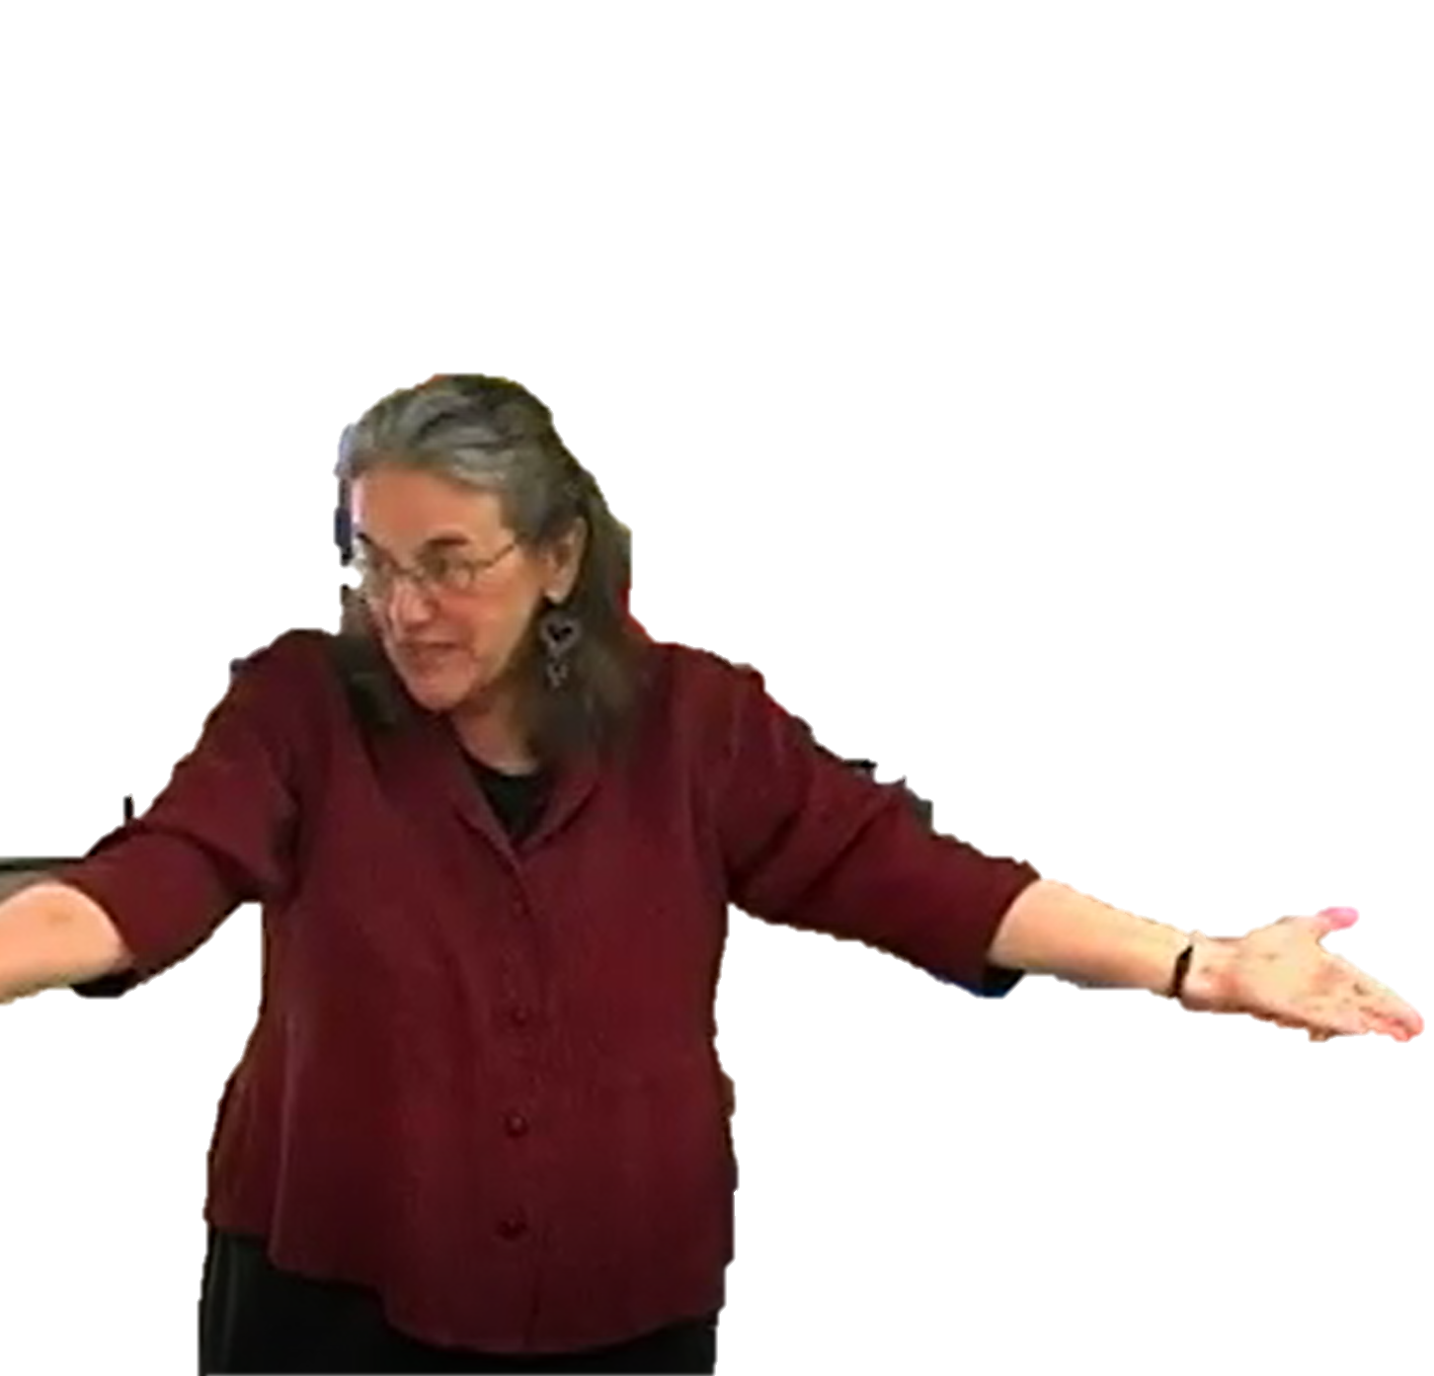
Match the explanation to the learning outcome
Match
explanation
learning outcome
Match
explanation
learning outcome
means
the explanation
helps meet
the learning outcome
describes
the actions required to reach the learning outcome
is
clear
concise
refers to observable behaviors (actions)
shows mastery of the objective
skill development
knowledge acquistion
I’ll ask a question, I will put up my hands. This says think do not blurt, and when I lower my hands right there you’ll say the answer.
put up my hands
Students will respond chorally after teacher signal
respond chorally
teacher signal
say the answer

Slide 93
Checklist: Modeling Give clear explanations
Give clear explanations
Match the explanation the learning outcome
Design the explanation so that it is correct, clear, and concise
Use the explanation consistently
Model multiple planned examples
Show all the steps or provide unique examples
Verbalize your process and thinking
Have students observe
Use supporting practices

Slide 94
Clear Explanation Checklist
The explanation is designed so it is
correct
accurate
complete
clear
is immediately comprehensible
has the simplest possible student- and discipline-appropriate vocabulary and syntax
is not awkward-sounding
concise

Slide 95
Why is such precision necessary for explanations?
What is the core deficit in many learning disabilities and difficulties?
Students who need intensive intervention often need help understanding language
We need to manage our language carefully to help students
If we do not, the cognitive load becomes quickly unmanageable
We have to be very clear for the benefit of our students
disorder in one or more of the basic
psychological processes involved in understanding or using language
“‘Specific learning disability’ means a disorder in one or more of the basic psychological processes involved in understanding or using language, spoken or written, which may manifest itself in an imperfect ability to listen, think, speak, read, write, spell, or to do mathematical calculation.
IDEA (2004)

Slide 96
Checklist: Modeling Give clear explanations—correct
The explanation is designed so it is
correct
accurate
complete
clear
is immediately comprehensible
has the simplest possible student- and discipline-appropriate vocabulary and syntax
is not awkward-sounding
concise
Fundamental and non-negotiable

Slide 97
Correct: Accurate—What does that mean?
The explanation correctly specifies
critical elements (more on this later)
The explanation does not include
incorrect facts
an imprecise procedure
misspellings or incorrect grammar

Slide 98
Is Ms. Peters’ explanation accurate?
Ms. Peters teaches Grade 1 word reading skills to Grade 2 students
Objective:
Pronounce aw as /aw/
Declarative knowledge
Read words containing the /aw/ sound spelled aw.
Procedural knowledge
Is the explanation accurate?
Accurate:
The explanation correctly specifies critical elements
The explanation does not include, incorrect facts, an imprecise procedure, misspellings, or incorrect grammar
Axelson, N. (n.d.) PALS. Warren, RI: Axelson Academy

Slide 99
Let’s watch Ms. Peters provide instruction
We have a new sound today.
Can you say the sound?
/aw/.
/aw/
maybe?
Everyone say it again.
/aw/
maybe?
/aw/
Axelson, N. (n.d.) PALS. Warren, RI: Axelson Academy

Slide 100
Is Ms. Peters’ explanation accurate?
What is her explanation?
She gives it after she has the students say it
Is it accurate?
Everyone say it again.
/aw/.
The explanation (a team effort between her and the students) includes the critical element, the pronunciation /aw/.
The explanation is not connected with the letters AW.
Nothing is incorrect
Note that this is a known routine, and students knew the pronunciation anyway. She may have judged it was not be important to say spelling.
Accurate:
The explanation correctly specifies critical elements
The explanation does not include, incorrect facts, an imprecise procedure, misspellings, or incorrect grammar

Slide 101
Correct: Accurate—How?
Start by writing the objective
Visualize the learning outcome
Figure out what you do not understand
Seek guidance
Your teacher’s guide for your secondary prevention program
Trustworthy online resources
Colleagues
Workshops
If you’re not sure, punt
Move on to something else
Seek immediate guidance
Try again

Slide 102
Correct: Complete—What is complete?
A complete explanation
includes all critical information to do the skill or understand the idea
matches the learning outcome exactly
breaks complex ideas into parts
does not leave students to intuit complex ideas
Procedural
In physics we want to understand how things work and why they work the way they do.
Retell the story by looking back at the story carefully. Write what happened.
Declarative
Definition missing critical information:
Is this the complete definition of physics?
Explanation missing critical information:
What do you do when you look back?
How should someone be careful?
How do you decide what to write?

Slide 103
Activity 5.15 Video example: Is this complete?
Ms. S is teaching a strategy called the “Fix It” game.
The objectives:
Students will recognize when they have read a sentence incorrectly because it does not make sense in context
Students will be able to apply this as a “fix it” strategy when reading
Is Ms. S’s explanation complete?
These videos are part of professional learning community (PLC) materials for the IES practice guide Foundational Skills to Support Reading for Understanding in Kindergarten Through 3rd Grade prepared for the Institute of Education Sciences (IES) under Contract ED-IES-12-C-0011 by the Regional Educational Laboratory Southeast administrated by Florida State University. https://www.youtube.com/watch?v=Kmy4VOKM2q8&index=33&list=PLVHqsnePfULo3KA8dspX6558xwZxVr2rB

Slide 104
Activity 5.15 Ms. S’s explanation: Is it complete?
Link to Video: https://youtu.be/Kmy4VOKM2q8?t=41 (stop at 01:19)
Students will recognize when they have read a sentence incorrectly because it does not make sense in context
Students will be able to apply this as a “fix it” strategy when reading
These videos are part of professional learning community (PLC) materials for the IES practice guide Foundational Skills to Support Reading for Understanding in Kindergarten Through 3rd Grade prepared for the Institute of Education Sciences (IES) under Contract ED-IES-12-C-0011 by the Regional Educational Laboratory Southeast administrated by Florida State University.

Slide 105
Activity 5.15 Review
Students will recognize that a sentence they read does not make sense in context
Students will apply the “fix it” strategy when reading when it does not make sense.
recognize that a sentence
does not make sense
We practice making sure that when we read it makes sense. It has to look right and it also has to make sense. and there’s a question that might help you if you’re reading.
You can ask yourself, “Did that make sense?”
And if the answer’s “no,” you can go back and try to fix it so it can make sense.
ask yourself, “Did that make sense?”

Slide 106
Activity 5.15 Review
Students will recognize that a sentence they read does not make sense in context
Students will apply the “fix it” strategy when reading when it does not make sense.
apply the “fix it” strategy
We practice making sure that when we read it makes sense. It has to look right and it also has to make sense. and there’s a question that might help you if you’re reading.
You can ask yourself, “Did that make sense?”
And if the answer’s “no,” you can go back and try to fix it so it can make sense.
try to fix it
try to fix it?

Slide 107
Correct: Complete—How?
Match it to behavioral learning outcome
Procedural: Break it into short steps (“chunks”) to reduce cognitive load
Declarative: Define or describe it clearly (see “clear” section)
Write the procedure or explanation (use “clear” guidance also)
Read it aloud
Reread it
Try doing the skill or answering questions based on it
Try using it with an adult
Read it to them
Ask them to do something
Rewrite it
Create the rest of the lesson and change as needed

Slide 108
Correct explanation: Summary
Accurate explanation:
correctly specifies
critical elements of the skill or idea
does not include
incorrect facts
an imprecise procedure
misspellings or incorrect grammar
Complete explanation:
includes all critical elements of the skill or idea
matches the learning outcome exactly
breaks complex ideas into parts
does not leave students to intuit parts of skill or idea

Slide 109
Curriculum example: Accurate and complete explanation?
Objective: Student will add three-digit numbers with or without regrouping using the standard algorithm
Add the ones.
If the answer is more than 9, regroup.
Write ones answer.
Add the tens.
If the answer is more than 9, regroup.
Write tens answer.
Add the hundreds.
If the answer is more than 9, regroup. Write hundreds answer.
Accurate explanation:
correctly specifies critical elements of the skill or idea
does not include incorrect facts, an imprecise procedure, misspellings, or incorrect grammar
Complete explanation:
includes all critical elements of the skill or idea
matches the learning outcome exactly
does not leave students to intuit parts of skill or idea
Accurate?
For the standard algorithm, this is correct
Nothing is incorrect
Complete?
All parts are there, including regrouping
Perfect match
Nothing intuited
place value and regrouping knowledge are required
Resource available from NCII
https://intensiveintervention.org/sites/default/files/PlaceValueComp_508.pdf

Slide 110
Curriculum example: Accurate and complete explanation?
Objective: Student will identify that the vowel-consonant-E pattern makes the long sound and use the pattern to read words.
Magic e has magic powers!
He flies over the consonant and when he comes to the first vowel, he taps the vowel on the head with his magic wand and shouts, “vowel, say your name! Make the sound you say in the alphabet!”
Now, Magic e is so tired. He flies back to his spot. He has no more energy so he goes to sleep without saying a sound.
Accurate explanation:
correctly specifies critical elements of the skill or idea
does not include incorrect facts, an imprecise procedure, misspellings, or incorrect grammar
Complete explanation:
includes all critical elements of the skill or idea
matches the learning outcome exactly
does not leave students to intuit parts of skill or idea
Accurate?
No. The skill is not really described
There are not facts.
Complete?
It does not show the procedure, with or without steps
Maybe pronunciation. Not reading.
The analogy requires a lot of cognitive effort to understand
Information from Make, Take, & Teach
http://blog.maketaketeach.com/activities-for-teaching-the-magic-e-rule/

Slide 111
Activity 5.16 Analyze Curricular Materials
Objective: Student will identify that the vowel-consonant-E pattern makes the long sound and use the pattern to read words.
An E close behind another vowel (with no more than one letter in between) usually makes the first vowel say its name, and the E is usually silent.
Accurate explanation:
correctly specifies critical elements of the skill or idea
does not include incorrect facts, an imprecise procedure, misspellings, or incorrect grammar
Complete explanation:
includes all critical elements of the skill or idea
matches the learning outcome exactly
does not leave students to intuit parts of skill or idea
Here’s another way of explaining the vowel-consonant-E pattern. Examine the checklist and decide if it meets each criterion.
Information from Make, Take, & Teach
http://blog.maketaketeach.com/activities-for-teaching-the-magic-e-rule/

Slide 112
Activity 5.16 Review
Objective: Student will identify that the vowel-consonant-E pattern makes the long sound and use the pattern to read words.
An E close behind another vowel (with no more than one letter in between) usually makes the first vowel say its name, and the E is usually silent.
Accurate explanation:
correctly specifies critical elements of the skill or idea
does not include incorrect facts, an imprecise procedure, misspellings, or incorrect grammar
Complete explanation:
includes all critical elements of the skill or idea
matches the learning outcome exactly
does not leave students to intuit parts of skill or idea
Accurate?
Mostly correct. Is it supposed to help with ie as well? It sort of does.
No apparent ones
Complete?
Is it necessary to add “usually”?
Matches the first part (second is a natural extension)
Nothing intuited
Information from Make, Take, & Teach
http://blog.maketaketeach.com/activities-for-teaching-the-magic-e-rule/

Slide 113
Checklist: Modeling Give clear explanations—clear
The explanation is designed so it is
correct
accurate
complete
clear
is immediately comprehensible
has the simplest possible student- and discipline-appropriate vocabulary and syntax
is not awkward-sounding
concise

Slide 114
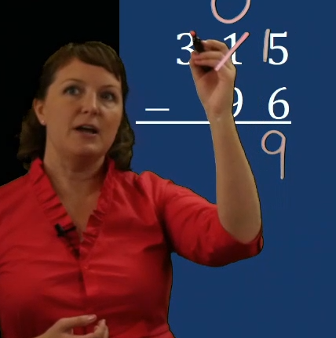
Clear: Immediately comprehensible
Comprehensible
As concrete as possible (imageable vocabulary)
As focused as possible (no extraneous information)
easy to follow
concrete? focused? easy to follow?
I’m going to regroup 1 ten for 10 ones.
Light things are easy to pick up. Heavy things are hard to pick up.
Rhyming words sound the same at the end.

Slide 115
Clear: Immediately comprehensible
Comprehensible
As concrete as possible (using imageable vocabulary)
As focused as possible (without extraneous information)
easy to follow
concrete? focused? easy to follow?
Procedural
Data is another word for information we collect about something.
Declarative
We can rewrite fractions when the number of parts in each whole are the same.
$$\frac{3}{4}+\frac{1}{4}$$
Vague terms: about something
Not easy to follow: “collect about”
Vague terms: parts, whole, same
Not easy to follow: “parts in each whole are the same”

Slide 116
Activity 5.17 Pause & Process
Comprehensible
As concrete as possible
(using imageable vocabulary)
As focused as possible
(without extraneous information)
easy to follow
Example | Comprehensible?
Congruence means identical in form or shape, like all the circles around the room, but not necessarily size, like the circles are many different sizes.
When we practice we do something again and again.
To fill a liquid measuring cup partway, match the line on the side of the cup with the amount you need. Then, slowly pour your liquid into the cup. When the amount of liquid reaches the line, stop pouring.
Let’s write lowercase d. First, we go between the bottom and middle lines and make a circle. Then, we go to the top and down to the bottom, staying on the right side of the circle.
Let’s prepare to write a formal email. Start with the email address. You should have this already. Make sure it is spelled correctly. Then, add a subject stating the purpose of the email. Keep it short, maybe 5 to 10 words or maybe a few more. Start with a formal greeting like “Dear Ms. Harris.” Don’t say “Hey” or “Hi there” because it can send the wrong message.

Slide 117
Activity 5.17 Review
Comprehensible
As concrete as possible
(using imageable vocabulary)
As focused as possible
(without extraneous information)
easy to follow
Example | Comprehensible?
Congruence means identical in form or shape, like all the circles around the room, but not necessarily size, like the circles are many different sizes. | Concrete. Some extraneous information. That might make it harder to follow.
When we practice we do something again and again. | Concrete. Phrases “do something” and “again and again” are common. It is focused. It is easy to follow.
To fill a liquid measuring cup partway, match the line on the side of the cup with the amount you need. Then, slowly pour your liquid into the cup. When the amount of liquid reaches the line, stop pouring. | Concrete. Most nouns and verbs are imageable. It is very focused and easy to follow.
Let’s write lowercase d. First, we go between the bottom and middle lines and make a circle. Then, we go to the top and down to the bottom, staying on the right side of the circle. | Not concrete. “Go between,” “go to,” and “staying on” are vague. It is focused. Language makes it hard to follow.
Let’s prepare to write a formal email. Start with the email address. You should have this already. Make sure it is spelled correctly. Then, add a subject stating the purpose of the email. Keep it short, maybe 5 to 10 words or maybe a few more. Start with a formal greeting like “Dear Ms. Harris.” Don’t say “Hey” or “Hi there” because it can send the wrong message. | Concrete. Not focused; many tangents. Extraneous information makes it harder to follow.

Slide 118
Clear: Has the simplest possible appropriate vocabulary and syntax
Simplest possible vocabulary
at students’ current level of performance
using words with unambiguous concrete meanings
including phrases
Appropriate vocabulary
Using instructional level-appropriate academic language
Using discipline-specific terms for concepts (e.g., quotient; quadrilateral; inference; protagonist; constitutional)
rhyming words…
have the same vowel and sounds after it
sound the same at the end
conclude respond persist nevertheless
regroup
borrow

Slide 119
Clear: Has the simplest possible appropriate vocabulary and syntax
Syntax (sentence and grammatical structure) to avoid
Passive voice
is a way of writing where the subject is “buried”
Complex sentences
are cases where sentences have a main clause and a dependent clause
Involves conjunctions like although, as, unless, where, while
The subjunctive
is a verb mood referring to hypothetical events
requires complex sentences and uses words like if, supposing, could, might have
The videos were watched by them.
While they were watching the videos, the cat escaped.
If this had been, um. Say we had 17 cards and this was an 8 and this would have been a 7, we wouldn’t have to regroup there. OK?
43
- 19
an 8
a 7

Slide 120
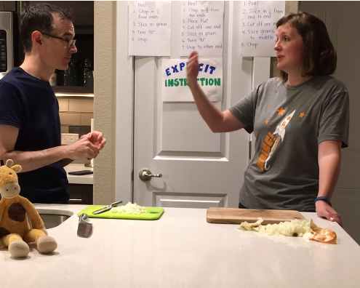
Adjust vocabulary and syntax as you plan
Peel the onion
Slice in ½ from end to end
Cut off one end
Slice grains to middle
Chop

Slide 121
Adjust vocabulary Third time’s the charm!
Peel
Chop in ½ from ends
Slice on grain
Turn 90 degrees
Chop
Peel
Chop in ½ from the ends
Place flat
Cut off one end
Slice on grain
Turn 90 degrees
Chop to other end
Peel the onion
Slice in ½ from end to end
Cut off one end
Slice grains to middle
Chop
Use more precise discipline-specific vocabulary
Simplify syntax
What else might we change?

Slide 122
Adjust vocabulary Changing the PALS partner reading strategy
Peer-Assisted Learning Strategies (PALS) partner reading strategy
Students work in pairs with a reader and a “coach” (other student)
If the reader makes a mistake, the coach uses a correction procedure
The procedure changed over time…
Stop. You missed a word. Point at word. Can you figure it out?
?
Point at word. Check it.
coach
1997 edition
2008 revision

Slide 123
Adjust vocabulary Getting the Gist
Getting the Gist strategy is part of Collaborative Strategic Reading (CSR; Klingner, Vaughn, & Boardman, 2005)
A slight adaptation was created for a content-area literacy instruction (CALI) project by Jade Wexler, me, and Christopher J. Lemons
How are these different? Are the changes in CALI improvements?
CSR version
CALI version
Gist Steps
Name the “who” or “what” the section of text is mostly about.
What is the most important information about the “who” or “what”?
Write the gist in approximately 10 words or less.
Gist Steps
Identify who or what the section is mostly about.
Identify the most important information about the who or what.
Develop a Gist Statement that is about 10 words.

Slide 124
Clear: Is not awkward-sounding
Contains words you can say again and again
Light and heavy: Light things are easy to pick up. Heavy things are hard to pick up.
Metaphor: a creative description
If I say, “That car is a dinosaur! It’s time to get a new one,” that’s a metaphor, a creative description. The car isn’t a dinosaur really. What am I saying about the car? Everyone?
Right, that’s a metaphor, a creative description to say the car is old.
Another metaphor is, “Our principal, Mr. González, is a walking encyclopedia.” What is this creative description saying about him?
The metaphor describes Mr. Gonzalez creatively. It tells you knows a lot.
creative description
It’s old!
creative description
creative description
He’s smart.
describes creatively

Slide 125
Clear: Is not awkward-sounding
An influence is a person or event that motivates a person to become what they become.
Martin Luther King was an important influence on many other civil rights leaders, he motivated them to become what they became.
become what they became
How many times could you say “become what they became”?
The entire civil rights movement influenced later activists who campaigned for equal rights for many people. The civil rights movement motivated them to become what they became, civil rights activists.
become what they became

Slide 126
A non-awkward explanation: ambivalent
Google Dictionary: having mixed feelings or contradictory ideas about something or someone.
Dictionary.com: having mixed feelings about someone or something; being unable to choose between two (usually opposing) courses of action
Merriam-Webster Online: having or showing simultaneous and contradictory attitudes or feelings toward something or someone
What would be a non-awkward explanation?
“If you are ambivalent about something, you have two opposite opinions and cannot decide on one.”
Explanation
“Some citizens are ambivalent about universal healthcare—they have two opposite opinions, so they cannot decide on one.”
Test

Slide 127
Activity 5.18 Analyze a Video Example
Dr. Archer teaches a lesson on cause and effect
Her objective is for students to correctly identify causes and effects in a recently read text
What is her explanation of cause and effect?
Is it smooth and not awkward-sounding?

Slide 128
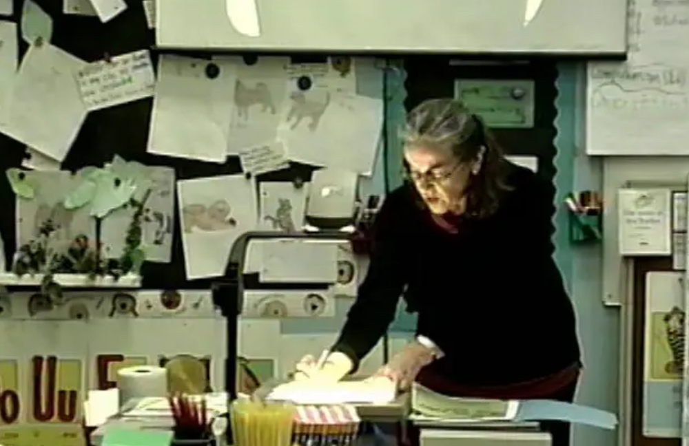
Activity 5.18 Analyze a Video Example
Link to Video: https://explicitinstruction.org/video-elementary/elementary-video-9/

Slide 129
Activity 5.18 Review
When we have a cause, is always something that happens first.
What is her explanation?
She mostly focuses on the terms “then” and “because”
Is it smooth and not awkward-sounding?
The word “then” ends up being kind of awkward because it seems to get mixed up with sequence
Dr. Archer says “so” and “as a result” at certain points but does not focus on those
It also seemed like she was stuck in a cause-effect loop
☺

Slide 130
Curriculum Example: Is this clear?
Today we’re going to learn a secret letter team. A secret letter team is two letters working together as a team, but they are not next to each other. Here’s our secret letter team (point to I_E box on sound page). In this secret letter team, the letters I (point to I) and E (point to E) work together. They say /ī/. What does the letter team say?
Student: /ī/.
Yes, /ī/. But, there is also this blank space (point to blank). In a word, a letter goes here. I and E work as a team to say /ī/, but it’s a secret letter team because they are separated! This secret letter team is I-BLANK-E.
The explanation
is correct (accurate and complete)
is immediately comprehensible, concrete, focused, and easy to follow
has the simplest possible student- and discipline-appropriate vocabulary and syntax
is not awkward-sounding?
yes (if you think “secret” is OK)
sort of (maybe with the visual)
yes
yes (if you don’t mind “secret”)

Slide 131
Checklist: Modeling Give clear explanations—concise
The explanation is designed so it is
correct
accurate
complete
clear
is immediately comprehensible
has the simplest possible student- and discipline-appropriate vocabulary and syntax
is not awkward-sounding
concise

Slide 132
Concise
Omit needless words!
Include only details needed for this objective
Make it as short as possible
Eliminate information that is
extra (interesting but non-essential)
useful—but not now
easy to infer if absent

Slide 133
How we became more concise…
Peel
Chop in ½ from ends
Slice on grain
Turn 90 degrees
Chop
Peel
Chop in ½ from the ends
Place flat
Cut off one end
Slice on grain
Turn 90 degrees
Chop to other end
Peel the onion
Slice in ½ from end to end
Cut off one end
Slice grains to middle
Chop
Eliminating information that is easy to infer

Slide 134
Activity 5.19 Pause & Process:
Examine these explanations for the different pronunciations of the letter C.
In what ways are they not clear or concise?
What explanation would you give?
In circle, C that says /k/ as we know. But the other C says /s/, and that’s because of the I. E and Y work the same way.
A clear, concise explanation
Clear
is immediately comprehensible
has the simplest possible level-appropriate vocabulary and syntax
is not awkward-sounding
Concise
has only the details needed for the objective
is as short as possible
C is a letter switcher. Letter switcher C usually says /k/ but when it comes before E, I, and Y, it says /s/.
C has a hard sound /k/ and a soft sound /s/ while it says the soft sound /s/ when it comes before E, I, and Y.
C says /s/ before E, I, and Y.
So, when C comes before A, O, or U, it says /k/. When it comes before E, I, and Y, it says /s/.
We’ll try /s/ for C when it comes before E, I, and Y.

Slide 135
Activity 5.19 Review
In circle, C says /k/ as we know. But the other C says /s/, and that’s because of the I. E and Y work the same way.
Not an explanation. It is an example that sort of describes the pattern. Too long.
Has inappropriate vocabulary, namely a made-up word (“letter switcher”) that requires high-effort explicit thinking to use. Too long.
C is a letter switcher. Letter switcher C usually says /k/ but when it comes before E, I, and Y, it says /s/.
Not immediately comprehensible. “Before” has a meaning related to time and a meaning related to place.
Has unnecessary details (hard” and “soft”) and complex syntax (with “whle” and “when” clauses). Too long.
C has a hard sound /k/ and a soft sound /s/ while it says the soft sound /s/ when it comes before E, I, and Y.
C says /s/ before E, I, and Y.
So, when C comes before A, O, or U, it says /k/. When it comes before E, I, and Y, it says /s/.
Has unnecessary details. It is technically accurate. However, /k/ is the “default” pronunciation, the one they already know.
Is awkward-sounding: “Try /s/ for C” might be hard to say many times. Has inappropriate vocabulary: “Try” is too vague to make clear /s/ should definitely do this.
We’ll try /s/ for C when it comes before E, I, and Y..
C says /s/ when followed by E, I, or Y.

Slide 136
Activity 5.20 Discussion Board (to help our elders)
Write an explanation for how to send a text message from a smart phone
Design it for an older person who does not know how to use a cell phone very well
Begin with the phone set to the home screen
Rewrite the explanation
Share both and discuss how yours and others’ align with the checklist
The explanation
is correct (accurate and complete)
is immediately comprehensible, concrete, focused, and easy to follow
has the simplest possible student- and discipline-appropriate vocabulary and syntax
is not awkward-sounding?

Slide 137
Activity 5.20 Review
First try
From the main screen, gently tap the speech bubble one time.
Tap the pencil one time.
Tap the 123 button.
Tap the numbers to type the number.
Press Return
Tap the gray “Text Message” box.
Type the message by tapping the letters.
Tap the up arrow one time.
Second try
Tap speech bubble.
Tap pencil.
Tap 123 button
Type the whole phone number
Tap Return
Tap gray “Text Message” box
Type message.
Tap Up arrow.
Use icons and make sure “tap” and “type” are known prior knowledge.
A clear, concise explanation
Clear
is immediately comprehensible
has the simplest possible level-appropriate vocabulary and syntax
is not awkward-sounding
Concise
has only the details needed for the objective
is as short as possible
yes
yes
mostly
yes
yes?
sort of
yes
no?
mostly
no
Bonus points if you actually tried to help someone with your explanation!

Slide 138
Checklist: Modeling Use the explanation consistently
Give clear explanations
Match the explanation the learning outcome
Design the explanation so that it is correct, clear, and concise
Use the explanation consistently
Model multiple planned examples
Show all the steps or provide unique examples
Verbalize your thinking
Have students observe
Use supporting practices

Slide 139
Clear Explanation: Use it consistently
Repeat the same explanation until students can use it
Use the exact same words—variability can be confusing
(Archer & Hughes, 2011)

Slide 140
Clear Explanation: Use it consistently
Mr. Xu teaches a student to match shapes
This is a new skill for this student, who recently learned the identities of the shapes
He uses the steps (on the chart)
How many times is the third step repeated during the lesson?
Was it necessary to do this?
Identify the shape.
Find the shape.
Draw a line to connect the shapes.
(Archer & Hughes, 2011)

Slide 141
Activity 5.21 Analyze a Video Example
Time Stamp | Phase | Description
0:28-0:32 | Explanation | T reads from checklist during explanation

Slide 142
Activity 5.21 Analyze a Video Example
Link to Video: https://youtu.be/eFKiVGJIncU

Slide 143
Activity 5.21 Review
Time Stamp | Phase | Description
0:28-0:32 | Explanation | T reads from checklist during explanation
0:48-0:52 | Model (1) | T reads directions for practice worksheet
1:36-1:42 | Model (1) | T reads from checklist during model
2:24-2:37 | Model (2) | T prompts S to state the step
2:41-2:45 | Model (2) | T prompts S to read checklist
3:28-3:32 | Practice | T prompts S to state the step
3:33-3:38 | Practice | S states the step

Slide 144
Checklist: Modeling Model multiple planned examples
Give clear explanations
Match the explanation the learning outcome
Design the explanation so that it is correct, clear, and concise
Use the explanation consistently
Model multiple planned examples
Show all the steps or provide unique examples
Verbalize your thinking
Have students observe
Use supporting practices

Slide 145
Is modeling really necessary?
We might model too much
Could we just give an explanation sometimes (frequently?)

Slide 146
Let’s try the explanation by itself
Objective:
You will be able to tie a necktie using a simple knot.

Slide 147
Explanation Part 1
Drape the tie around your neck with the seam-side hidden. Cross the ends with the narrow end behind the wide one. Make sure the wide end hangs longer.

Slide 148
Explanation Part 2
Loop the wide end around the back of the narrow end.
Keep looping the wide end so it crosses the front and goes to the back again.

Slide 149
Explanation Part 3
Pull the wide end up through the back. Then, slide the wide end between the front part of the loop and the short end of the tie. Pull it down to finish the knot.

Slide 150
Activity 5.22 Stop & Jot
What was effective about the explanation?
Would you be ready to practice after this explanation? Explain.

Slide 151
Activity 5.22 Review
What was effective about the explanation?
The language was (relatively) clear
The graphics helped visualize the process

Slide 152
Activity 5.22 Review
Explain why you would or would not be ready to practice after this.
I would not: The words do not explain the terms or accurately describe the movements
I would not: The images are not always helpful
“seam-side”?
“cross the ends”?

Slide 153
Explanations require models
A clear explanation is necessary but not sufficient in most cases
Models
make the explanation clearer
eliminate ambiguity
reduce the cognitive load when learning new skills

Slide 154
Checklist: Modeling Model multiple planned examples
Give clear explanations
Match the explanation the learning outcome
Design the explanation so that it is correct, clear, and concise
Use the explanation consistently
Model multiple planned examples
Show all the steps or provide unique examples
Verbalize your thinking
Have students observe
Use supporting practices

Slide 155
Model: Show all the steps or provide unique examples
BEST Strategy
Break the word apart
Examine the base word
Say each part
Try the whole word
O’Connor et al., 2015
Model
Show all the steps—for procedures
Address everything included in the clear explanation
These are often called “worked examples”
This sometimes involves templates or organizers
Provide unique examples—for knowledge
Provide examples that enhance the learner’s understanding
If you are being too loud with your friends, your parents might interfere.
Some companies have interfered with the Great Barrier Reef by dumping sand into it.
If you are doing homework and you have to think about the answer for a while, that’s not interference.
If two of your friends start arguing and you separate them and tell them to calm down, you are interfering.

Slide 156
Show all the steps
In this video, does Sarah model all of the steps? How does she make sure Devin remembers them?

Slide 157
Showing all the steps
Link to Video: https://youtu.be/kM87C2fPxsM

Slide 158
Show all the steps
Does Sarah model all of the steps?
Yes
How does she make sure Devin remembers them?
She refers to the checklist as she goes
She uses the language consistently
She has Devin participate

Slide 159
Video example Provide unique examples
My objective: Students will learn the definition of the word disembark
What part is an explanation and what part is a model?
What would be one enhancement in terms of providing unique examples?

Slide 160
Video example Provide unique examples
Link to Video: https://youtu.be/eMPfEgdzsJI

Slide 161
Video example Provide unique examples
What part is an explanation and what part is a model?
Explanation: Just the definition
Model: Examples
What would be one enhancement in terms of providing unique examples?
Vary the examples—perhaps with different vehicles
Use non-examples—maybe getting out of a car

Slide 162
Verbalize your thinking
Sometimes described as doing “think-alouds”
For procedures
Explain what you are thinking as you complete each step
Elaborate on the checklist
For knowledge
Explain how an example matches what you have already taught them
Explain non-examples for the same reason
Verbalize your thinking
The students are not doing the work yet

Slide 163
Curriculum Example
The rule is that each part must have a vowel. What’s the rule? ____
Let me show you how I split these words so each part has a vowel. This word is splatter. What word? ____
Watch me split it. Cover TER with card. Does this part (point at splat) have a vowel? ____ The A. So, that part has a vowel so it follows that rule.
Let’s look at the other part. Move card and cover SPLAT. Does this part have a vowel? ____ The E. So it follows the rule.
OK, let me do it again. Move to scamper and cover ER. Point at SCAMP. Now, what is the first rule? ____ Good. This part has a vowel, so it follows the rule. Why does it follow the rule? ____
Objective: Students will identify words that are broken into parts that each have a vowel.
How does the program have the teacher verbalize thinking?

Slide 164
Have students observe
Do
have students watch carefully
use supporting practices to keep students engaged in cognitively processing the content
continuously elicit responses related to content you just taught
Do not
have students do or say anything that expects them to have an answer you have not given
ask students to guess
What do you know about Ellis Island?
What’s the problem?
Students might know little or wrong things

Slide 165
Lead Teacher Demonstration: Modeling
Ms. Leonard teaches students about the A-consonant-E pattern
Compare and contrast the two examples
Does her model align with the checklist?
Model multiple planned examples
Show all the steps or provide unique examples
Verbalize your thinking
Have students observe

Slide 166
Lead Teacher Demonstration: Modeling
Link to Video: https://youtu.be/OzkfpCn3wtA

Slide 167
Lead Teacher Demonstration: Modeling
Link to Video: https://youtu.be/VdYYvCqBmTw

Slide 168
Lead Teacher Demonstration: Modeling
Example 1
There were two steps, and she showed both
She explained how she did it
She did not make the students do it
Example 2
There was a simple explanation but not a procedure
There was no thinking to verbalize
She immediately asked the students to do the work
Model multiple planned examples
Show all the steps or provide unique examples
Verbalize your thinking
Have students observe

Slide 169
Activity 5.23 Part 1 Analyze a Video Example
Objective: The students will use knowledge of sound-spellings to chain words by changing one sound-spelling at a time
Does the model meet the criteria for effective modeling?
Model multiple planned examples
Show all the steps or provide unique examples
Verbalize your thinking
Have students observe

Slide 170
Activity 5.23 Part 1 Analyze a Video Example
Link to Video: https://youtu.be/4Tm2U2zOQ_M?t=33
(stop at 01:33)

Slide 171
Activity 5.23 Part 1 Review
Does the model meet the criteria for effective modeling?
She shows all of the steps
She verbalizes what she is doing (there’s nothing deeper)
She has students observe only (she states this very clearly)
Model multiple planned examples
Show all the steps or provide unique examples
Verbalize your thinking
Have students observe

Slide 172
Activity 5.23 Part 2 Analyze a Video Example
Objective: The students will state the main idea of a picture using the gist strategy
Does the model meet the criteria for effective modeling?
Model multiple planned examples
Show all the steps or provide unique examples
Verbalize your thinking
Have students observe

Slide 173
Activity 5.23 Part 2 Analyze a Video Example
Link to Video: https://youtu.be/MXLek726ww4?t=28
(stop at 02:35)

Slide 174
Activity 5.23 Part 2 Review
Does the model meet the criteria for effective modeling?
She gives the explanation of all the steps, but she does not show the students how to do them herself
She does not verbalize her own thinking (or verbalize for the students)
She has students do the work rather than just observe
Model multiple planned examples
Show all the steps or provide unique examples
Verbalize your thinking
Have students observe

Slide 175
Checklist: Modeling Use supporting practices
Give clear explanations
Match the explanation the learning outcome
Design the explanation so that it is correct, clear, and concise
Use the explanation consistently
Model multiple planned examples
Show all the steps or provide unique examples
Verbalize your thinking
Have students observe
Use supporting practices

Slide 176
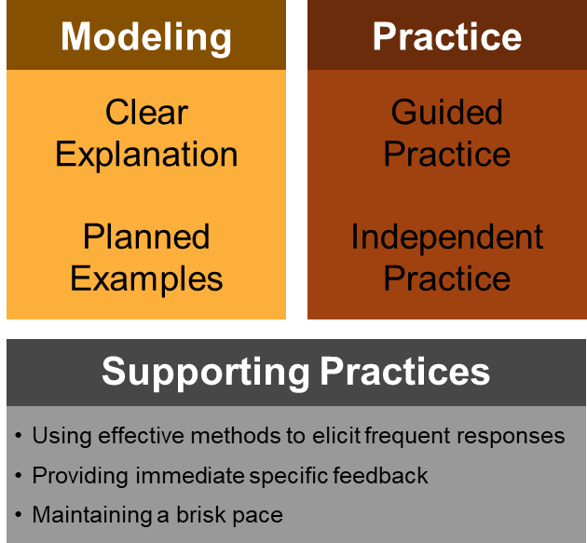
Supporting practices during modeling
Designed to maximize cognitive processing of lesson content
Eliciting responses
Actively engaging students in model
Not having them do the thinking
Providing feedback
Affirming correct responses
Correcting misunderstandings
Maintaining a brisk pace
Modeling quickly
Knowing when to move on

Slide 177
Slide 177
Activity 5.24
I’ll start it…
The lesson will be a curriculum example
It is a beginning reading lesson
The objective given by the program is “to understand relationships between letters and sounds”

Slide 178
Activity 5.24 I’ll start it…
There is no specific learning outcome related to the objective, but the activities do not seem to match very well.
Objective: “understand relationships between letters and sounds”
Lesson Warm-up
Have children name the pets in the illustration that goes with the poem. Elicit the word dog, and write it on the board. Tell the children that they will learn about the sound they hear at the beginning of dog and the letter that stands for that sound.
Ask children to read the first line of the poem. Have them find dog and match it with the word dog on the board. Then have children read the following pairs of words. Ask them to repeat each pair of words and tell them which word in the pair begins with the same beginning sound as dog: dig, jig, dime, rhyme, date, gate, fill, dill, rug, dug
Call attention to the word dog on the board. Ask children to name the letter that stands for the sound they hear at the beginning of dog. A volunteer can draw a line under the letter d.
Give clear explanations
Match the explanation the learning outcome
Design the explanation so that it is correct, clear, and concise
Use the explanation consistently
Model multiple planned examples
Show all the steps or provide unique examples
Verbalize your thinking
Have students observe
Use supporting practices

Slide 179
Activity 5.24 I’ll start it…
Lesson Warm-up
Have children name the pets in the illustration that goes with the poem. Elicit the word dog, and write it on the board. Tell the children that they will learn about the sound they hear at the beginning of dog and the letter that stands for that sound.
Ask children to read the first line of the poem. Have them find dog and match it with the word dog on the board. Then have children read the following pairs of words. Ask them to repeat each pair of words and tell them which word in the pair begins with the same beginning sound as dog: dig, jig, dime, rhyme, date, gate, fill, dill, rug, dug
Call attention to the word dog on the board. Ask children to name the letter that stands for the sound they hear at the beginning of dog. A volunteer can draw a line under the letter d.
Objective: Students will identify spoken words that begin with the /d/ sound and associate them with the letter d.
Explanation
We already know this letter. What letter? d. We also know the sound of d. What is it? /d/. We are going to listen to the first sound in words and … you finish it.
Model
My turn first. Hold up dog picture. This says dog. What does it say? Dog. Now, I … you finish it.
… Write two more cycles of modeling.

Slide 180
Activity 5.24 And now that you’ve finished it …
Objective: Students will identify spoken words that begin with the /d/ sound and associate them with the letter d.
Explanation
We already know this letter. What letter? d. We also know the sound of d. What is it? /d/. Listen to the first sound of a word. If it makes the /d/ sound, hold up your d card. If not, don’t hold up your card.
Model
My turn first. Hold up dog picture. This says dog. What does it say? Dog. Now, I think, is the first sound in dog /d/? /d…og/. Yes! So, I hold up my d card. Now you hold up your d card too! Have students hold up cards.
And two more cycles with cat and pig.

Slide 181
Slide 181
Part 2 Wrap-Up
Complete Activities
Activity 5.25: Journal Entry*
Activity 5.26: Try Modeling
Activity 5.27: Discussion Board*
* Online

Slide 182
Slide 182
Activity 5.25 Prepare a model
Activity 5.26 Try out your model
Try out your model
Prepare a good model
Create a brief lesson with
a clear objective with a specific learning outcome
a clear explanation of the procedure or information
a description of the models used
After teaching the lesson, write a reflection comparing your lesson to the checklist
Plan to do your lesson
Review your clear explanation and write it out to review as you teach
Adjust your plan so it is less than 10 minutes
Do the lesson
Work from your written plan
Focus on the explanation and teacher-led model
Teach just 10 minutes

Slide 183
Activity 5.27 Discussion Board Post
Post your journal entry and a description of how your lesson went
Read others’ lessons and descriptions and discuss them relative to the checklist
Respond to evaluations of your lesson based on your interpretation of this module part
Bonus points: Film the lesson, share it, and discuss it with others

Slide 184
Slide 184
Explicit Instruction
Modeling and practicing to help students reach academic goals
Part 3: When and how should students practice in explicit instruction lessons?

Slide 185
Slide 185
Module objectives
You’ll learn how to
decide when students are ready for practice
provide guided practice
provide independent practice
decide the best next step based on practice

Slide 186
Role of practice in explicit instruction
Even amazing modeling does not matter if students never get direct practice
Modeling
Practice
Clear Explanation
Guided
Practice
Planned Examples
Independent Practice
Supporting Practices
Using effective methods to elicit frequent responses
Providing immediate specific feedback
Maintaining a brisk pace

Slide 187
Practice in the DBI context
If a student does not respond, diagnostic assessment data might indicate an instructional problem
Increasing explicitness of instruction is one adaptation designed to change instruction
When increasing explicitness, an important question concerns the source of the problem within the explicit instruction framework
If clear explanations and models are in place, the problem might concern the way practice happens
So, this is why we are discussing practice

Slide 188
Why are guided and independent practice both important?
Why are explanations and modeling not sufficient?
Why do we need guided and independent options?
Some procedures are so complex that
students need active but limited participation to start
immediate independent practice would overtax cognitive resources
Some procedures are so simple that
students can execute them well immediately
guiding them through the practice would waste time
It’s like learning from TV documentaries
practice makes us commit to learning
It’s like learning computer programming
practice reveals the many possible holes

Slide 189
Checklist: Practice
Decide what type of practice is appropriate
Design outcome-aligned practice likely to produce high accuracy
Provide guided practice
Lead student in steps toward the learning outcome
Provide appropriate prompts
Observe and provide immediate feedback
Provide independent practice
Review expectations and resources for meeting the learning outcome
Allow student to work without support
Observe and provide immediate and delayed feedback
Make strategic decisions about next steps

Slide 190
Module Activities
Brief examples
Knowledge-building activities
Knowledge-building curriculum example
Construct a guided practice based on the checklist
Knowledge-building activities
Discussions on checklists and helping others
Try out your lesson
Lead teacher demonstration to compare ways to provide guided practice

Slide 191
Checklist: Practice Decide on appropriate type of practice
Decide what type of practice is appropriate
Design outcome-aligned practice likely to produce high accuracy
Provide guided practice
Lead student in steps toward the learning outcome
Provide appropriate prompts
Observe and provide immediate feedback
Provide independent practice
Review expectations and resources for meeting the learning outcome
Allow student to work without support
Observe and provide immediate and delayed feedback
Make strategic decisions about next steps

Slide 192
Deciding what is appropriate
Complexity of the skill
High?
Probably guided
Low?
Possibly independent—or guided with a plan to quickly move to independent
There are many different options…

Slide 193
Slide 193
Lesson Time Frame
Modeling
Guided Practice
Independent Practice
Modeling
Guided Practice
Independent Practice
Modeling
Guided Practice
Independent Practice
Modeling
Guided Practice
Modeling
Independent Practice
M
G
I
M
G
I
M
G
I
M
G
I
M
G
I
M
G
I
M
G
I
M
G
I
M
G
I

Slide 194
Checklist: Practice Design outcome-aligned practice
Decide what type of practice is appropriate
Design outcome-aligned practice likely to produce high accuracy
Provide guided practice
Lead student in steps toward the learning outcome
Provide appropriate prompts
Observe and provide immediate feedback
Provide independent practice
Review expectations and resources for meeting the learning outcome
Allow student to work without support
Observe and provide immediate and delayed feedback
Make strategic decisions about next steps

Slide 195
Outcome-aligned high-accuracy practice
Outcome-aligned
Practice the learning outcome from the objective
Practice as was done in the model
High-accuracy
Should be at the same level of complexity as the model
Should produce
80-85% correct responses during guided practice
90-95% correct responses during independent practice

Slide 196
Checklist: Practice Provide guided practice
Decide what type of practice is appropriate
Design outcome-aligned practice likely to produce high accuracy
Provide guided practice
Lead student in steps toward the learning outcome
Provide appropriate prompts
Observe and provide immediate feedback
Provide independent practice
Review expectations and resources for meeting the learning outcome
Allow student to work without support
Observe and provide immediate and delayed feedback
Make strategic decisions about next steps

Slide 197
What is guided about guided practice
Complex tasks are practiced in parts
Teacher reviews one step
Student completes that step … and cycle
Simple tasks are practiced together
Teacher and student do practice in unison
Teacher provides feedback
Knowledge is reviewed with scaffolding
Teacher provides related information but not the knowledge itself
The teacher gives “hints”
Student recalls idea
All types of objectives are practiced with teacher decision-making
Teacher uses supporting practices including providing feedback
Teacher uses feedback to decide to model or do either practice type

Slide 198
Checklist: Practice Provide guided practice
Decide what type of practice is appropriate
Design outcome-aligned practice likely to produce high accuracy
Provide guided practice
Lead student in steps toward the learning outcome
Provide appropriate prompts
Observe and provide immediate feedback
Provide independent practice
Review expectations and resources for meeting the learning outcome
Allow student to work without support
Observe and provide immediate and delayed feedback
Make strategic decisions about next steps

Slide 199
Lead student in steps toward the learning outcome
For a procedural task—execute each step separately
For knowledge—address each “kernel” (unit) of knowledge (e.g., one vocabulary word) at a time

Slide 200
Lead student step-by-step
Objective: Student will use the onion-cutting procedure to dice an onion.
Does this meet our criteria for step-by-step guided practice?
Lead student in steps towards learning outcome
Procedural Task: Execute each step separately
Knowledge Task: address each unit (e.g. vocabulary word) one at a time

Slide 201
Lead student step-by-step
Link to Video: https://youtu.be/6Hm8ENdz4tM

Slide 202
Lead student step-by-step
Lead student in steps towards learning outcome
Procedural Task: Execute each step separately
Knowledge Task: address each unit (e.g. vocabulary word) one at a time
A procedural task
Sarah reviewed each step as we did them
Each step is completed before moving on
Feedback is provided with each step

Slide 203
Activity 5.28 Analyze a Video
Objective: Students will segment word into individual sounds using tokens
Is this an example of step-by-step guided practice?
Lead student in steps towards learning outcome
Procedural Task: Execute each step separately
Knowledge Task: address each unit (e.g. vocabulary word) one at a time
These videos are part of professional learning community (PLC) materials for the IES practice guide Foundational Skills to Support Reading for Understanding in Kindergarten Through 3rd Grade prepared for the Institute of Education Sciences (IES) under Contract ED-IES-12-C-0011 by the Regional Educational Laboratory Southeast administrated by Florida State University

Slide 204
Activity 5.28 Analyze a Video
Link to Video: https://youtu.be/6wjU03hjOvs?t=82 (stop at 02:22)
These videos are part of professional learning community (PLC) materials for the IES practice guide Foundational Skills to Support Reading for Understanding in Kindergarten Through 3rd Grade prepared for the Institute of Education Sciences (IES) under Contract ED-IES-12-C-0011 by the Regional Educational Laboratory Southeast administrated by Florida State University

Slide 205
Activity 5.28 Review
Lead student in steps towards learning outcome
Procedural Task: Execute each step separately
Knowledge Task: address each unit (e.g. vocabulary word) one at a time
Is this an example of step-by-step guided practice?
What is the task?
Procedural
Does the teacher lead students through each step?
Yes—She states each step before students complete them
Is each step executed separately?
Yes—Students complete a step before moving on
Cycle is repeated with each new word
These videos are part of professional learning community (PLC) materials for the IES practice guide Foundational Skills to Support Reading for Understanding in Kindergarten Through 3rd Grade prepared for the Institute of Education Sciences (IES) under Contract ED-IES-12-C-0011 by the Regional Educational Laboratory Southeast administrated by Florida State University

Slide 206
Checklist: Practice Provide guided practice
Decide what type of practice is appropriate
Design outcome-aligned practice likely to produce high accuracy
Provide guided practice
Lead student in steps toward the learning outcome
Provide appropriate prompts
Observe and provide immediate feedback
Provide independent practice
Review expectations and resources for meeting the learning outcome
Allow student to work without support
Observe and provide immediate and delayed feedback
Make strategic decisions about next steps

Slide 207
Provide appropriate prompts
Design a variety of prompt types linked to task and likely student need
Change level of prompting in response to student’s progress
More supportive …
Smallest steps
Most verbalization
Most reminders before student starts
Less supportive
Larger steps
Less verbalization
Fewer reminders before student starts

Slide 208
Design a variety of prompt types linked to task and likely student need
What is a prompt?
A way of reminding
A way for the teacher to support students
It should lead them to the right answer but not give them the answer
What are different prompts
Verbal … directives, questions, reminders
Visual/Non-verbal … checklists, visual schedules, images for words
Physical … hand gestures, hand-over-hand support for physical tasks

Slide 209
Provide appropriate prompts
Objective: Student will match shapes in same size and direction
Does this meet our criteria for providing appropriate prompts?
Provide appropriate prompts
Design a variety of prompt types linked to task and likely student need
Change level of prompting in response to student’s progress
Xin Xu

Slide 210
Provide appropriate prompts
Link to Video: https://youtu.be/bJKGXrIQUyU
Xin Xu

Slide 211
Provide appropriate prompts
Provide appropriate prompts
Design a variety of prompt types linked to task and likely student need
Change level of prompting in response to student’s progress
Variety of prompt types?
Verbal: questions/reminders of each step
Change level of prompting to match student’s progress?
Yes—Student accurately performs each step and does not need additional prompts
Yes—Teacher asks questions to ensure student understanding
Xin Xu

Slide 212
Activity 5.29 Analyze Curricular Materials
Objective: Students will use moon-related vocabulary words correctly.
Define the terms gibbous, waxing, waning
A list of vocabulary words is displayed on the screen.
Teacher says the new word and students repeat the word.
The teacher and students read the definition of each word together.
The teacher elaborates on the definitions by giving examples and hand gestures to illustrate each (gibbous = hand over fist for larger than half)
An incomplete sentence is displayed on the screen:
It is the first quarter, so the moon is ______.
If the moon is not half, full, or new, it is a _________ moon.
Students complete the sentence by selecting the appropriate moon-related vocabulary word.
Provide appropriate prompts
Design a variety of prompt types linked to task and likely student need
Change level of prompting in response to student’s progress
Here’s a way of reviewing students’ knowledge of moon-related vocabulary words. Examine the checklist and decide how to incorporate appropriate use of prompts.

Slide 213
Activity 5.29 Analyze Curricular Materials
Objective: Students will use moon-related vocabulary words correctly.
Define the terms gibbous, waxing, waning
A list of vocabulary words is displayed on the screen.
Teacher says the new word and students repeat the word.
The teacher and students read the definition of each word together.
The teacher elaborates on the definitions by giving examples and hand gestures to illustrate each (gibbous = hand over fist for larger than half)
An incomplete sentence is displayed on the screen:
It is the first quarter, so the moon is ______.
If the moon is not half, full, or new, it is a _________ moon.
Students complete the sentence by selecting the appropriate moon-related vocabulary word.
Provide appropriate prompts
Design a variety of prompt types linked to task and likely student need
Change level of prompting in response to student’s progress
Variety of prompts?
Verbal hints: “In the first quarter, we start to see more of the moon. Which word do we use when we are seeing more?”
Gestures (if applicable): [Teacher shows students the gibbous gesture.]
Change level of prompting?
Higher level: See examples above
Lower level: “Think about the first quarter.”

Slide 214
Checklist: Practice Provide guided practice
Decide what type of practice is appropriate
Design outcome-aligned practice likely to produce high accuracy
Provide guided practice
Lead student in steps toward the learning outcome
Provide appropriate prompts
Observe and provide immediate feedback
Provide independent practice
Review expectations and resources for meeting the learning outcome
Allow student to work without support
Observe and provide immediate and delayed feedback
Make strategic decisions about next steps

Slide 215
Observe and provide immediate feedback
Watch student carefully
Interpret the meaning of errors
Provide feedback that aligns with the type of error
Questions to ask as you observe
Is the student moving toward mastery?
Does the student say and do things that demonstrate progress toward mastery of learning outcome?
Where in the process are mistakes occurring?

Slide 216
Observe and provide immediate feedback
Objective: Students complete sentence segmentation activity using tokens
Does this meet our criteria for observing and providing immediate feedback?
How many times does the teacher identify student error and provide feedback?
Did the type of feedback align with the type of error?
Observe and Provide Immediate Feedback
Watch students carefully
Interpret the meaning of errors
Provide feedback that aligns with the type of error
These videos are part of professional learning community (PLC) materials for the IES practice guide Foundational Skills to Support Reading for Understanding in Kindergarten Through 3rd Grade prepared for the Institute of Education Sciences (IES) under Contract ED-IES-12-C-0011 by the Regional Educational Laboratory Southeast administrated by Florida State University

Slide 217
Activity 5.30 Analyze a Video Example
Time Stamp | Error Type | Feedback Provided
0:27 – 0:54 | Student does not move tokens | Individual support provided; T guides S to move tokens

Slide 218
Activity 5.30 Analyze a Video Example
Link to Video: https://youtu.be/qc6qMzRL4Fg?t=156 (stop at 04:30)
These videos are part of professional learning community (PLC) materials for the IES practice guide Foundational Skills to Support Reading for Understanding in Kindergarten Through 3rd Grade prepared for the Institute of Education Sciences (IES) under Contract ED-IES-12-C-0011 by the Regional Educational Laboratory Southeast administrated by Florida State University

Slide 219
Activity 5.30 Review
Observe and Provide Immediate Feedback
Watch students carefully
Interpret the meaning of errors
Provide feedback that aligns with the type of error
Teacher observes each student’s response
Teacher identifies when errors occur
Teacher provides feedback with 1-1 support, verbal prompts and questions to guide students to correct response
Time Stamp | Error Type | Feedback Provided
0:27 – 0:54 | Student does not move tokens | Individual support provided; T guides S to move tokens
1:20 - 1:30 | Students did not repeat “green” in the sentence | T provides a verbal reminder; S repeat the sentence again
1:31 – 1:43 | Students repeat the same error above | T provides a verbal hint (what color was his hat?); S repeat the sentence again

Slide 220
Checklist: Practice Provide guided practice
Decide what type of practice is appropriate
Design outcome-aligned practice likely to produce high accuracy
Provide guided practice
Lead student in steps toward the learning outcome
Provide appropriate prompts
Observe and provide immediate feedback
Provide independent practice
Review expectations and resources for meeting the learning outcome
Allow student to work without support
Observe and provide immediate and delayed feedback
Make strategic decisions about next steps

Slide 221
Lead Teacher Demonstration: Guided Practice
Ms. Leonard teaches students how to use a number line to add numbers
Compare and contrast the two examples
Does the video align with the guided practice checklist?
Providing Guided Practice
Lead students in steps towards learning outcomes
Provide appropriate prompts
Observe and provide immediate feedback

Slide 222
Lead Teacher Demonstration: Guided Practice
Link to Video: https://youtu.be/sJ0cbrDSFS4

Slide 223
Lead Teacher Demonstration: Guided Practice
Link to Video: https://youtu.be/VdYYvCqBmTw

Slide 224
Lead Teacher Demonstration: Guided Practice
Non-Example
Does not lead students in each step
Students jump right into independent practice
No opportunity to provide prompts
No opportunity to provide feedback
Example
Leads students in each step before moving on
Provides verbal prompts: “everyone, the answer to 4 + 2 is _______”
Provides immediate feedback: “your finger should be on the number 4”
Providing Guided Practice
Lead students in steps towards learning outcomes
Provide appropriate prompts
Observe and provide immediate feedback

Slide 225
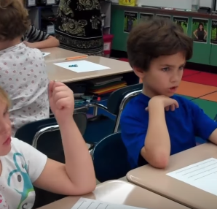
Activity 5.31 Analyze a Video Example
Objective: Students will identify individual phonemes in spoken words
Does this meet our criteria for providing guided practice?
Providing Guided Practice
Lead students in steps towards learning outcomes
Provide appropriate prompts
Observe and provide immediate feedback
Axelson Academy (2017)
Notes:
Let’s put it all together!

Slide 226
Activity 5.31 Analyze a Video Example
Link to Video: https://youtu.be/LqxLhTAEe-w?t=52
Axelson Academy (2017)

Slide 227
Activity 5.31 Review
Teacher states each step as students do them
Each step is completed before moving on
Teacher provides prompts as needed
Verbal reminders of steps
Pointing to tokens
Teacher provides immediate feedback on the board and circles around the room to check student work
Providing Guided Practice
Lead students in steps towards learning outcomes
Provide appropriate prompts
Observe and provide immediate feedback
Axelson Academy (2017)

Slide 228
Curriculum Example
OK, now we’re getting it! Now, I want you to help me with reading little parts of the text and talk about the parts clearly.
Here’s my next tricky sentence. “But when he lived and for a long time afterwards, his idea was no more than a guess.” So, what do we do first? Pause
OK. You decide the first little part, silently. Who would like to say the first little part? Wait 3 sec. Choose a student.
OK. Who else read the same little part? If no consensus, ask another student. If consensus, provide positive feedback and continue. What’s our next step? Pause
Good. You talk about it clearly to yourself. Pause for students to do this.
Partner 2, talk clearly to Partner 1. Pause. Could a Partner 1 share how Partner 2 talked clearly?
Select a student. Provide positive and corrective feedback as needed.
Repeat student-teacher practice procedure with the next sentence, beginning “And often…”.
If a third sentence seems necessary, do “Sometimes the things they did had good results, even though the ideas about why these things worked were wrong.”
Objective: Students will learn how to interpret and break down complex sentences.
How does this example meet the criteria for guided practice?
Providing Guided Practice
Lead students in steps towards learning outcomes
Provide appropriate prompts
Observe and provide immediate feedback

Slide 229
Curriculum Example
OK, now we’re getting it! Now, I want you to help me with reading little parts of the text and talk about the parts clearly.
Here’s my next tricky sentence. “But when he lived and for a long time afterwards, his idea was no more than a guess.” So, what do we do first? Pause
OK. You decide the first little part, silently. Who would like to say the first little part? Wait 3 sec. Choose a student.
OK. Who else read the same little part? If no consensus, ask another student. If consensus, provide positive feedback and continue. What’s our next step? Pause
Good. You talk about it clearly to yourself. Pause for students to do this.
Partner 2, talk clearly to Partner 1. Pause. Could a Partner 1 share how Partner 2 talked clearly?
Select a student. Provide positive and corrective feedback as needed.
Repeat student-teacher practice procedure with the next sentence, beginning “And often…”.
If a third sentence seems necessary, do “Sometimes the things they did had good results, even though the ideas about why these things worked were wrong.”
Providing Guided Practice
Lead students in steps towards learning outcomes
Provide appropriate prompts
Observe and provide immediate feedback
How does this example meet the criteria for guided practice?
Lead students in steps towards learning outcomes?
Provide appropriate prompts?
Observe and provide immediate feedback?

Slide 230
Checklist: Practice Provide independent practice
Decide what type of practice is appropriate
Design outcome-aligned practice likely to produce high accuracy
Provide guided practice
Lead student in steps toward the learning outcome
Provide appropriate prompts
Observe and provide immediate feedback
Provide independent practice
Review expectations and resources for meeting the learning outcome
Allow student to work without support
Observe and provide immediate and delayed feedback
Make strategic decisions about next steps

Slide 231
When do you use independent practice?
Students are able to replicate steps in the procedure or the key aspects of the skill with limited guidance or prompting

Slide 232
Checklist: Practice Provide independent practice
Decide what type of practice is appropriate
Design outcome-aligned practice likely to produce high accuracy
Provide guided practice
Lead student in steps toward the learning outcome
Provide appropriate prompts
Observe and provide immediate feedback
Provide independent practice
Review expectations and resources for meeting the learning outcome
Allow student to work without support
Observe and provide immediate and delayed feedback
Make strategic decisions about next steps

Slide 233
Review expectations and resources for meeting learning outcomes
Select objective-linked practice items that lead to 90-95% accuracy
Review expectations for meeting learning outcome
Remind students how they self-prompt

Slide 234
Checklist: Practice Provide independent practice
Decide what type of practice is appropriate
Design outcome-aligned practice likely to produce high accuracy
Provide guided practice
Lead student in steps toward the learning outcome
Provide appropriate prompts
Observe and provide immediate feedback
Provide independent practice
Review expectations and resources for meeting the learning outcome
Allow student to work without support
Observe and provide immediate and delayed feedback
Make strategic decisions about next steps

Slide 235
Allow students to work without support
Limit guidance from teacher
Monitor throughout independent practice
Give mini-reminders and record points of confusion

Slide 236
Checklist: Practice Provide independent practice
Decide what type of practice is appropriate
Design outcome-aligned practice likely to produce high accuracy
Provide guided practice
Lead student in steps toward the learning outcome
Provide appropriate prompts
Observe and provide immediate feedback
Provide independent practice
Review expectations and resources for meeting the learning outcome
Allow student to work without support
Observe and provide immediate and delayed feedback
Make strategic decisions about next steps

Slide 237
Observe and provide immediate feedback
Check for understanding throughout
Low accuracy – move to guided practice
High accuracy – finish explicit instruction cycle
Provide feedback following completion of task

Slide 238
Provide independent practice
Objective: Dr. Archer is reviewing vocabulary terms taught in a previous lesson.
Students are responding to review questions by writing answers on white boards and displaying their answers
Is this an example of independent practice?
Providing Independent Practice
Review expectations and resources for meeting the learning outcome
Allow student to work without support
Observe and provide immediate and delayed feedback
Archer, A. L.
https://explicitinstruction.org/video-secondary-main/secondary-video-4/

Slide 239
Provide independent practice
Link to Video: https://explicitinstruction.org/video-secondary-main/secondary-video-4/
Archer, A. L.
https://explicitinstruction.org/video-secondary-main/secondary-video-4/

Slide 240
Provide independent practice Review
Providing Independent Practice
Review expectations and resources for meeting the learning outcome
Allow student to work without support
Observe and provide immediate and delayed feedback
Reminded students that they previously learned term “radius”
Placed image of diagram on board
Students work independently to draw a radius on their diagram
Students hold up completed work for Dr. Archer to review
Dr. Archer provides immediate feedback on the board for students to check their understanding
Archer, A. L.
https://explicitinstruction.org/video-secondary-main/secondary-video-4/

Slide 241
How should independent practice take place?
Independent practice can occur throughout the day
It is not practice for homework
Reinforce on-task behavior during independent practice

Slide 242
Checklist: Practice Make strategic decisions about next steps
Decide what type of practice is appropriate
Design outcome-aligned practice likely to produce high accuracy
Provide guided practice
Lead student in steps toward the learning outcome
Provide appropriate prompts
Observe and provide immediate feedback
Provide independent practice
Review expectations and resources for meeting the learning outcome
Allow student to work without support
Observe and provide immediate and delayed feedback
Make strategic decisions about next steps

Slide 243
Students have mastered the objective…
Now what?
It depends if the lesson
was one in a series of short lessons to reach a larger objective
ended a segment of instruction where students met the goal
helped students achieve accuracy or fluency
is a step toward generalizing a skill

Slide 244
What are the options?
Do the next lesson in the sequence
Begin the next segment of instruction
Conduct additional lessons to build fluency
Help students use the specific skill to generalize
broader skills
cognitive processing of greater complexity

Slide 245
How do you choose?
Look at standards, the student’s goals, and the curriculum
Evaluate what you know about the student’s performance
Consider what will contribute most to the student’s general academic success

Slide 246
Slide 246
Part 3
Wrap-Up
Key Points:
Guided practice is not modeling or independent practice
Independent practice is an opportunity to show mastery
Always keep supporting practices in mind

Slide 247
Guided practice is not…
Modeling
Teacher does not do the work
Students are not simply listening and repeating things they’ve already learned
Independent Practice
Teachers work with students and lead them through process
Students actively participate in acquisition of skills of concept

Slide 248
Independent practice is an opportunity to demonstrate success with specific objective
It involves
focusing on showing mastery of the skill taught
addressing the same skill modeling and guided practice
the same kind of practice
It does not mean
providing an “extension” of the current lesson
having students challenge themselves to exceed the objective
It culminates in
mastery of the objective
a thoughtful decision about what to teach next

Slide 249
Always keep Supporting Practices in mind
Supporting Practices
Modeling
Practice
Clear Explanation
Guided
Practice
Modeling
Independent Practice
Supporting Practices
Using effective methods to elicit frequent responses
Providing immediate specific feedback
Maintaining a brisk pace

Slide 250
Slide 250
Explicit Instruction
Modeling and practicing to help students reach academic goals
Closing: What are the next steps?

Slide 251
Module in the context of the DBI framework
Key Questions
How would you determine that you needed to increase the explicitness of instruction?
What is the purpose of increasing explicitness when you already use a secondary prevention program?
How would you determine what aspect of your practice needed the most change?
How would you evaluate the quality of the changes you made?
How would you figure out if the changes increased student achievement?

Slide 252
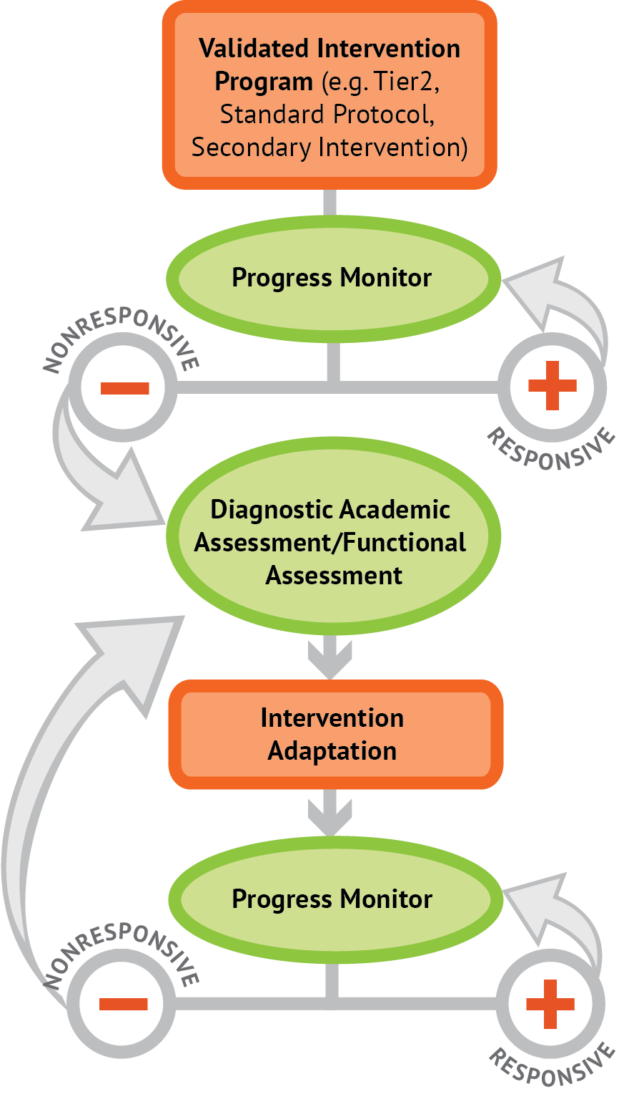
Activity 5.32 Partner Work
Discuss these key questions with a partner:
How would you determine that you needed to increase the explicitness of instruction?
What is the purpose of increasing explicitness when you already use a secondary prevention program?
How would you determine what aspect of your practice needed the most change?
How would you evaluate the quality of the changes you made?
How would you figure out if the changes increased student achievement?

Slide 253
Activity 5.32 Review
How would you determine that you needed to increase the explicitness of instruction?
Progress monitoring data would show a lack of response and diagnostic data would show misunderstandings about key parts of the objective
What is the purpose of increasing explicitness when you already use a secondary prevention program?
To improve the use of explicit instruction practices—either because
they are not stated in the program
the program is not sufficiently explicit
How would you determine what aspect of your practice needs the most change?
Examine the checklist and consider which of these things you do best and which you need help with.
How would you evaluate the quality of the changes you made?
Compare your work to the criteria on the checklist: If you’re doing those things, you’re on track
How would you figure out if the changes increased student achievement?
Students would show
greater mastery on daily formative (teacher-made) assessments
better progress monitoring results

Slide 254
Checklist: Practice
Decide what type of practice is appropriate
Design outcome-aligned practice likely to produce high accuracy
Provide guided practice
Lead student in steps toward the learning outcome
Provide appropriate prompts
Observe and provide immediate feedback
Provide independent practice
Review expectations and resources for meeting the learning outcome
Allow student to work without support
Observe and provide immediate and delayed feedback
Make strategic decisions about next steps

Slide 255
Slide 255
Module 5 Classroom Application
Application Activity
Journal Entry Assignment
Implement the lesson described in the last part of the Journal Entry Assignment.
After implementing, reflect with your coach about the effectiveness of the methods you used to provide explicit instruction.
Review an upcoming lesson in your classroom.
Create a plan for how you will:
Create an objective
Provide modeling
Provide guided practice, and
Provide independent practice
After teaching the lesson, write a reflection comparing your lesson to the checklist.

